Slide 1
Climate Change and Pension Funds
Notes:
Slide 1 Welcome

Slide 2
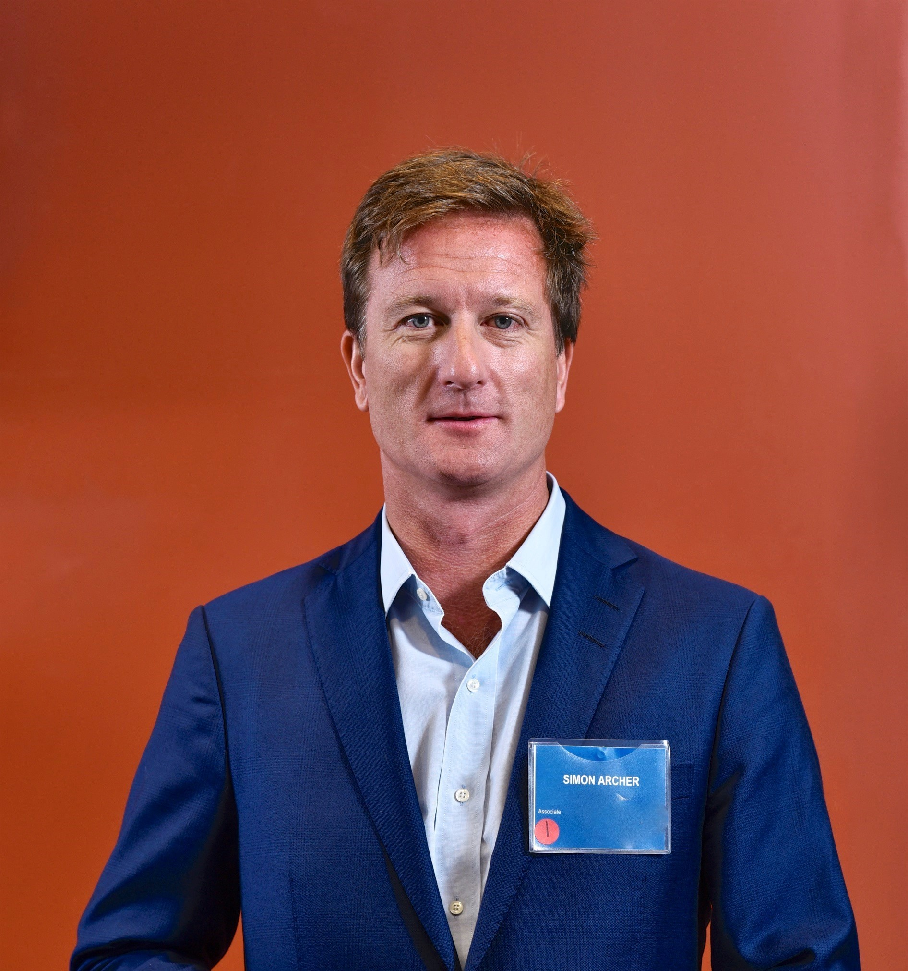
Canadian Climate Governance Expert
Simon Archer
Partner
Goldblatt Partners LLP
Notes:
Slide 2 Introduce self

Slide 3
About the Canada Climate Law Initiative
The Canada Climate Law Initiative is a national research initiative that works to clarify directors’ duties and fiduciary obligations related to climate change.
Our mission is to ensure Canadian directors and trustees understand their fiduciary obligations with respect to climate change, and have access to resources to help them govern with confidence in the area of climate-related financial risks and opportunities.
We offer free confidential board presentations and we maintain an online Knowledge Hub for Canadian directors and trustees.
Disclaimer: CCLI makes efforts to be as accurate as possible in sharing the information on these slides; however, for complete accuracy it is important to refer to the original sources. This presentation does not represent any legal, accounting or investment advice, please contact your lawyer, accountant or investment manager for any legal or other professional advice.
Notes:
Slide 3
CCLI is lead by:
Principal Investigators: Dr. Janis Sarra, Professor Cynthia Williams, and Dr. Carol Liao https://ccli.ubc.ca/who-we-are/our-principal-co-investigators/
Staff: Communications Manager, Sonia li Trottier trottier@allard.ubc.ca
CCLI’s programs
Our Climate Governance Experts offer free of charge, private, and confidential presentations to board directors, pension trustees and other fiduciaries. They are Canada’s leading lawyers, accountants, economists, capital markets experts, company executives, sustainable finance experts, and governance experts. They meet with senior executives to discuss issues particular to their sector and boards with a view to enhancing the conversation about effective climate governance. https://ccli.ubc.ca/our-experts/
We offer research and insights on the latest developments in sustainable finance, climate disclosure, and corporate governance. We also offer an online Knowledge Hub with information curated for Canadian directors and trustees.
CCLI is the Canadian partner of the Commonwealth Climate and Law Initiative at Oxford University, UK.
Research publications:
Life, Health, Property, Casualty: Canadian Insurance Company Directors and Effective Climate Governance
by Dr. Janis Sarra, March 2021
Directors’ Duties Regarding Climate Change in Japan
by Dr. Janis Sarra, Dr. Yoshihiro Yamada, and Dr. Masafumi Nakahigashi, February 2021
Audit Committees and Effective Climate Governance, A Guide for Boards of Directors
by Dr. Janis Sarra, December 2020
“Troubling Incrementalism’: Is the Canadian Pension Plan Fund Doing Enough to Advance the Transition to a Low-carbon Economy?”
by Professor Cynthia Williams, September 2020.
Time to Act: Response to questions posed by the Expert Panel on Sustainable Finance on Fiduciary Obligation and Effective Climate-related Financial Disclosures
by Dr. Janis Sarra and Professor Cynthia Williams, January 2019.
Disclosure of Information Concerning Climate Change: Liability Risks and Opportunities
by Professor Cynthia Williams, April 2018.
Fiduciary Obligations in Business and Investment: Implications of Climate Change
by Dr. Janis Sarra, April 2018.
Directors’ Liability and Climate Risk: Canada – Country Paper: Commonwealth Climate and Law Initiative (CCLI)
by Dr. Janis Sarra and Professor Cynthia Williams, April 2018.

Slide 4
What are the likely trends related to climate risk?
Notes:
Slide 4 Introduction
Recognition of financial materiality of climate change; wide acceptance that climate change is a systemic risk that can have a material impact on the financial position, performance, and prospects of companies.
The Bank of Canada reports that climate change looms as a potentially large structural change affecting the economy and the financial system, creating opportunities for innovation and investment but also posing economic transition risks:
“Changes in climate policies, technology or market sentiment could lead to economic dislocation and a reassessment of the value of a variety of financial assets. In particular, climate change–driven alteration of projected earnings and expenses could affect the debt repayment capacity and collateral of borrowers and increase credit risk borne by banks and other financial institutions. Given the degree of interconnectedness in the economy and the financial system, it is important to assess both the direct impacts of physical and transition risks, and the indirect and second-round effects. This implies accounting for exposures along the whole production chain, the transmission of shocks through financial linkages and feedback loops between the macroeconomy and the financial sector.”
Miguel Molico, ‘Researching the Economic Impacts of Climate Change, Implications for monetary policy and financial stability’, Bank of Canada (19 November 2019) https://www.bankofcanada.ca/2019/11/researching-economic-impacts-climate-change/
68 of 77 industry subsectors are materially affected by climate risk; this is 89% by market capitalization or US445.1T dollars exposed: ‘Climate risk technical bulletin,’ Sustainability and Accounting Standards Board April 2021

Slide 5
Some basic facts
Climate change is a real thing (denial from carbon industries and certain governments)
Caused by GHG emissions arising from human consumption
A whole-economy problem (not just energy, oil and gas problem)
Primary group generating climate change science and policy is the IPCC
Their work was used to create what is known as the “Paris accord”, a series of policy targets to be adopted globally, the objective of which is to reduce GHG emissions and limit global rise in average temperature to 1.5 degrees
Widely recognized we will not meet that objective (on track for 4 degrees)
The planet will be fine: the effect of working people and communities will be unprecedented
Question for unions and workers: where should we put our efforts?
Next few slides will show how this is normally described to trustees and pension fund stakeholders.

Slide 6
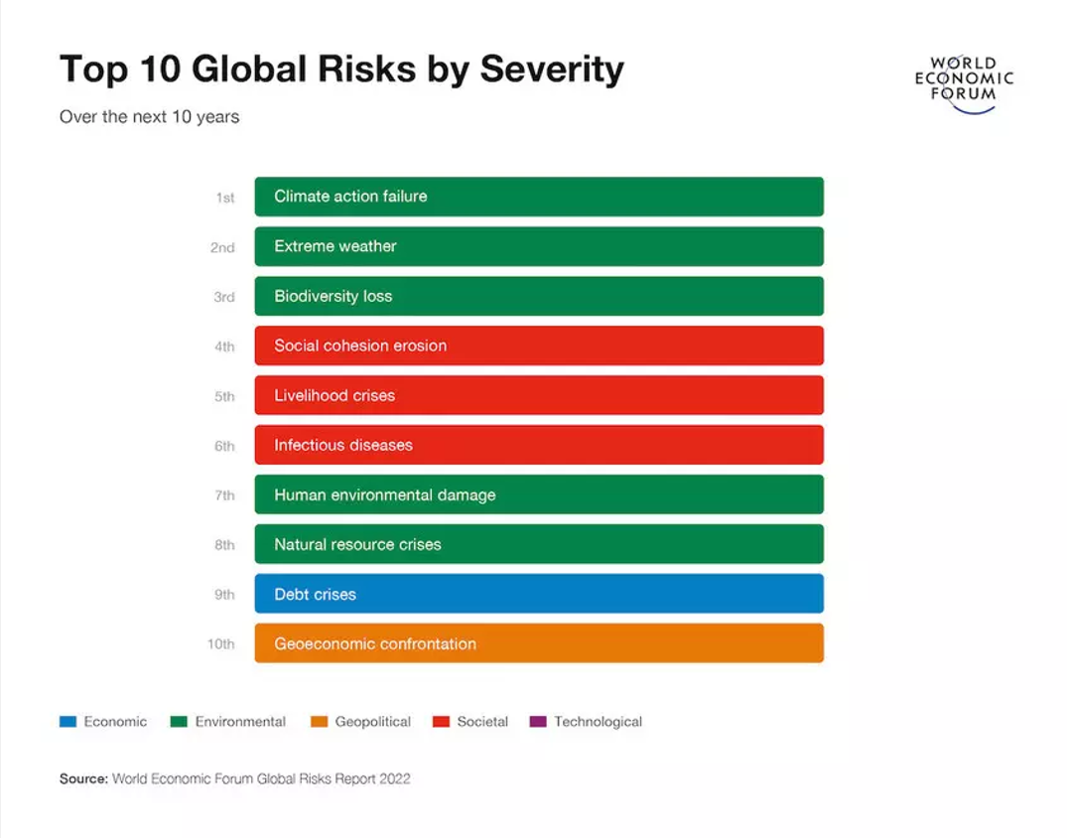
The ‘top three’ perceived severe risks over the next 10 years are all climate related
Notes:
Slide 5
The COVID-19 pandemic is expected to continue to have a substantial economic impact around the world.
However, extreme weather and climate action failure, are two of the ‘most likely’ global risks facing the world in 2021. Followed by environmental damage, infectious diseases and biodiversity loss.
Boards have learned from the COVID-19 crisis that there are dangers in not anticipating risks, and are now focusing on resilience and preparedness.
“The possibility that a catastrophic event can affect your business needs to be taken to account.”-Carol Hansell, Canada Climate Governance Expert, ‘Putting Climate Change Risk on the Boardroom Table’
The 2021 edition of the World Economic Forum’s Global Risks Report analyses the risks from societal fractures—manifested through persistent and emerging risks to human health, rising unemployment, widening digital divides, youth disillusionment, and geopolitical fragmentation. Businesses risk a disorderly shakeout which can exclude large cohorts of workers and companies from the markets of the future. Environmental degradation—still an existential threat to humanity—risks intersecting with societal fractures to bring about severe consequences. Yet, with the world more attuned to risk, lessons can be drawn to strengthen response and resilience. In 2020, the risk of a pandemic became reality. As governments, businesses, and societies grapple with COVID-19, societal cohesion is more important than ever.
Report can be found here: https://www.weforum.org/reports/the-global-risks-report-2021
Deloitte’s Centre for Board Effectiveness writes that while crisis management, disruption, and business continuity have long been key elements of risk management and board oversight, the severity of the challenges they posed in 2020 entail a much broader range of considerations. Prior to the COVID-19 pandemic, crisis management has often been short-term and/or relatively limited in scope (e.g. death or incapacity of an executive or damage to a production facility). In contrast, the pandemic that began in the first quarter of 2020, has continued, and seems likely to remain a challenge through a significant portion of 2021. As a result, boardroom agendas in 2021 are likely to include a renewed focus on how to survive a crisis, including looking backward with postmortems to assess how the business addressed the pandemic, as well as looking forward to determine where existing plans need improvement, updating playbooks to address a broader variety of crises, and engaging in wargaming exercises.
‘Never let a good crisis go to waste’, Debbie McCormack and Bob Lamm, Deloitte January 2021.
Read the report at https://www2.deloitte.com/us/en/pages/center-for-board-effectiveness/articles/the-2021-boardroom-agenda-never-let-a-good-crisis-go-to-waste-and-more.html.html

Slide 7
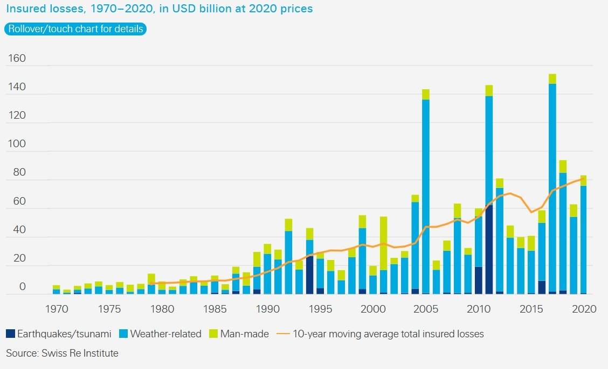
Severe weather and flood losses are on the rise
In Canada, payouts have more than doubled every 5-10 years since 1980s
Notes:
Slide 6
The number of recorded loss events resulting from natural disasters has been increasing for some years, along with payouts for these events. (Swiss Re Institute, Natural Catastrophes in 2020 https://www.swissre.com/institute/research/sigma-research/sigma-2021-01.html).
Less than one-third of losses are generally insured (Munich Re). Majority of losses are uninsured losses.
In Canada, insurance payouts from extreme weather more than doubled every five to 10 years since the 1980s. https://www.insuranceinstitute.ca/en/resources/insights-research/Climate-risks-report
Meteorological events such as hurricanes and hydrological events such as flooding dominate overall losses. Although with recent wildfires in Australia, Europe, California, and in B.C., loses from climatological events such as wildfires are on the rise.
Canada is experiencing increases in extreme rainfall and flooding, increased frequency and severity of wildfires, and sea level rise that is inundating fresh water.
2019 ranked the seventh highest in insured losses on record for Canada. Floods, rain, snow and windstorms damaged homes, vehicles and commercial properties and insured damage for these severe weather events reached $1.3 billion, according to Catastrophe Indices and Quantification Inc. http://www.ibc.ca/ab/resources/media-centre/media-releases/severe-weather-caused-1-3-billion-in-insured-damage-in-2019
Future global heating will be accompanied by an increase in the risk of extreme weather events such as heat waves, heavy rainfalls and related flooding, dry spells and/or droughts, and forest fires. This implies a risk to the value of financial assets, arising from climate- and weather-related events: Government of Canada, TCFD, 2019.
Munich Re report:
Natural disasters caused overall losses of more than US$5,200bn since 1980. Meteorological events dominate both overall losses and insured losses from natural catastrophes. Munich Re https://www.munichre.com/en/risks/natural-disasters-losses-are-trending-upwards.html
Meteorological events include storms, tornados, and hurricanes
Hydrological events include droughts and floods
Climatological events include wildfires
Geophysical events include earthquakes
Canadian stats:
Canadians and their insurers experienced significant losses from a host of severe weather events from coast to coast. http://www.ibc.ca/on/resources/media-centre/media-releases/severe-weather-caused-1-3-billion-in-insured-damage-in-2019
Insurance Bureau of Canada, 2019: Insurance payouts from extreme weather have more than doubled every five to 10 years since the 1980s. For the last nine years leading up to 2017, payouts for catastrophic losses have averaged $1.8 billion per year. The $1.9 billion in 2018 was due to ice storms, floods, windstorms and tornadoes, and was the 4th highest amount of losses on record, after the Québec ice storm in 1998, Calgary floods in 2013, and Fort McMurray wildfire in 2016. There are implications for the cost and availability of insurance and reinsurance.
First half 2021
Severe weather events
January: Storm Filomena (Madrid). Heaviest snowfall in five decades.
February: Polar Vortex (Texas). 3.5M left without power.
June: Heat Dome (Northwest US/Canada). Temperatures reached 46.6°C, fuelling wildfires.
July: Flooding events (Germany, Belgium, Netherlands, UK, India, China).
August: Wildfires (Russia, Greece, Italy, Turkey). Smoke from Siberia fires reaches north pole.
August: Hurricane Ida (Southern and Eastern US). 1M left without power.

Slide 8
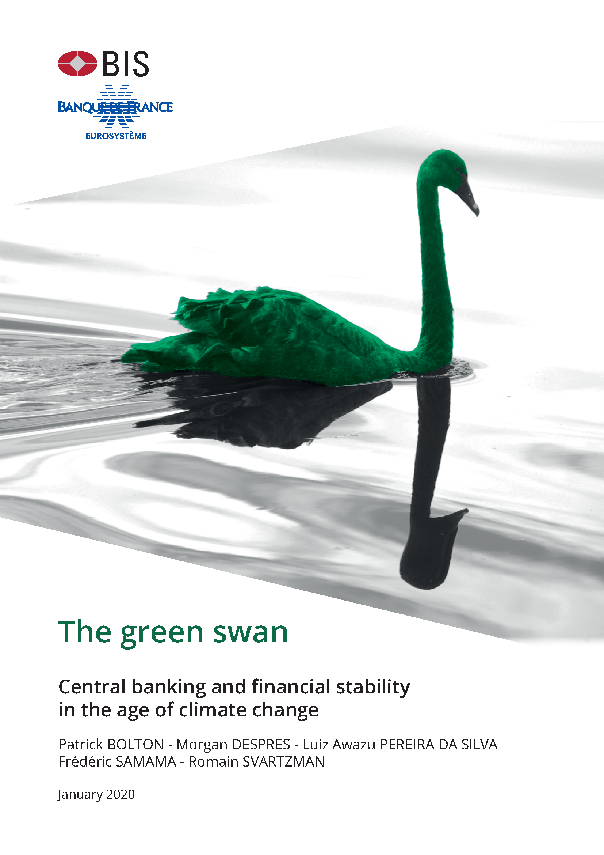
Climate change is a green swan
The next financial crisis?
The Bank of Canada has joined the Network for Greening the Financial System, and recognizes that climate change presents systemic financial risks and that financial institutions have a key role to play in facilitating the goals of the Paris Agreement.
Notes:
Slide 7
Central banks have recognized these risks, and see that they present a systemic risk to the entire financial system.
The impact of a so-called ‘green swan’ event, could be much more damaging than even the COVID pandemic.
105 central banks have formed the Network for Greening the Financial System, to understand how to evaluate and prepare for climate risk, as well as to identify the role finance can play to help the transition to a net-zero carbon economy.
The Bank of Canada is a member of this network, and recently completed a pilot to evaluate the risk climate change presents to Canada’s economy.
This pilot looks at 4 different possible ‘climate scenarios’:
one where all countries mobilize towards a 1.5 degree world immediately
one where nothing changes and we keep doing business as usual
And a third where we undergo a ‘disorderly transition’, where we take action but it’s too late, or it’s uncoordinated.
Swiss Re has estimated that Canada’s economy could lose 9 or 10% under a worst case scenario where we do nothing, or we could lose 4% of GDP under a ‘disorderly transition’ scenario.
They recognize that the impacts of climate change are so far reaching and potentially large-scale, that they could cause contagion and overwhelm the entire financial system, leading to global losses and instability, In 2020, the Basel Committee for Banking Supervision authored the ‘green swan’ report – identifying that climate change presents risks to financial stability and proposing that central banks must systematically identify, quantify, mitigate, and respond to climate risks in the financial system.
The Basel committee has also proposed principles to guide central banks, including that they perform climate-related ‘stress tests’, to determine how resilient the system will be to climate impacts, and what this means for the banking system and capital adequacy. This refers to the amount of capital banks are expected to hold to cover obligations in the event of shocks.
There are three main channels through which climate change can affect central banks’ primary mandate of price stability:
First, global warming is associated with a greater incidence of damaging climatic events, notably windstorms, extremes of precipitation and of temperature. These events may impact specific prices, notably food prices.
Second, the transition to a net zero carbon emission world may imply, at least for some time, sharp increases in the price of carbon, in turn affecting consumer prices directly through higher electricity, gas and petrol prices, and indirectly through increased costs of production for firms across a broad range of sectors.
Third, higher temperatures themselves may dampen economic activity and reduce labour productivity through higher rates of mortality and morbidity and overall lower efficiency. To the extent that this may reduce long-term growth potential and equilibrium interest rates, it may restrict the available space for conventional monetary policy.
https://voxeu.org/article/what-we-know-about-climate-change-and-inflation
The Bank of Canada recognizes climate change can affect the ability of central banks to achieve their goals for financial stability and inflation targeting. Two sets of risks are of particular concern: Physical risks from more frequent and severe extreme weather events. These can cause economic disruptions and losses to the financial system. And Transition risks, from the move toward a lower-carbon economy. Sudden or unexpected changes in consumer and investor preferences or in government policies that make pollution more expensive could raise financial system risks. A staff discussion paper in May 2020 outlined illustrative scenarios and the bank is now working with the Office of the Superintendent of Financial Institutions (OSFI) on a pilot project to use climate-change scenarios to better understand the risks to the financial system related to a transition to a net-zero economy. A small group of institutions from the banking and insurance sectors will participate voluntarily in the project.
Read the staff discussion paper here: https://www.bankofcanada.ca/wp-content/uploads/2020/05/sdp2020-3.pdf and news of the pilot project here: https://www.bankofcanada.ca/2020/11/bank-canada-osfi-launch-pilot-project-climate-risk-scenarios/
OSFI, ‘Navigating Uncertainty in Climate Change, Promoting Preparedness and Resilience to Climate-related Risks, (January 2021), 9 <https://www.osfi-bsif.gc.ca/Eng/Docs/clmt-rsk.pdf>
The Network for Greening the Financial System is a network of 83 central banks and financial supervisors that aims to accelerate the scaling up of green finance and develop recommendations for central banks' role for climate change. The NGFS was created in 2017 and its secretariat is hosted by the Banque de France. https://www.ngfs.net/en
Basel Committee on Banking Supervision issued a public consultation in November 2021 on principles for the effective management and supervision of climate-related financial risks. The consultation paper seeks to promote a principles-based approach to improve banks' risk management practices and supervisory practices related to climate-related financial risks. This follows the publication of a series of analytical reports earlier this year.
CDP: “We believe that improving corporate awareness through measurement and disclosure is essential to the effective management of carbon and climate change risk. We request information on climate risks and low carbon opportunities from the world’s largest companies on behalf of over 515 institutional investor signatories with a combined US $106 trillion in assets and 147 major purchasers with over US $4 trillion in procurement spend.”: Carbon Disclosure Project (CDP), https://www.cdp.net/en/climate.
The Sustainability Accounting Standards Board reports that climate risks affect 89% of US capital markets: SASB Climate Risk Technical Bulletin 2021, https://www.sasb.org/wp-content/uploads/2021/05/Climate-Risk-Technical-Bulletin2021-042821.pdf

Slide 9
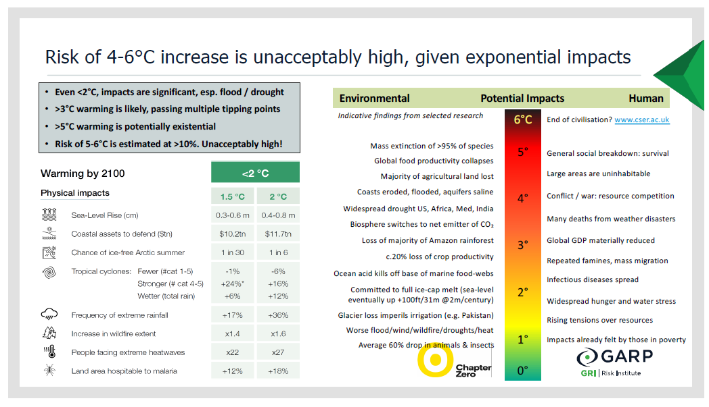
It’s not climate change, it’s everything change
Credit: GARP and Chapter Zero
Notes:
Slide 8
A stable climate underpins development of our civilization: climate data informs where it is safe to live, where to grow food, and where to build critical infrastructure.
The Intergovernmental Panel on Climate Change (IPCC) is publishing its Sixth Assessment Report (AR6) with a series of 3 working group reports. https://www.ipcc.ch/report/ar6/wg1/downloads/report/IPCC_AR6_WGI_SPM.pdf
With advances in climate science and modelling technology, and the ability to include data going even further back than before, the report paints a much clearer picture of the past, present and future climate.
The first report is the Physical Science Basis report, and it no longer equivocates on the human-causes of today’s changing climate. The report outlines how greenhouse gases (GHGs) contribute to global temperature increases.
The IPCC estimates that from 2011 to 2020, global surface temperature was 1.09°C higher than the 1850 to1900 pre-industrial average. https://www.ipcc.ch/report/ar6/wg1/downloads/report/IPCC_AR6_WGI_SPM.pdf
The magnitude of future warming depends on the extent of future carbon emissions mitigation.
The report offers five different scenarios (Representative Concentration Pathways, or RCP’s), that map out different emission scenarios which estimate how likely it is that the planet will cross different temperature thresholds in the future.
An optimistic scenario still allows us to keep global heating of the planet within the ‘guardrails’ of “well below 2, preferably 1.5 degrees Celsius”, as set out in the Paris Agreement at COP21 in 2015. This requires very low emissions (net-zero by 2050 and negative emissions thereafter) and sees warming held to 1.4°C by the end of the century.
Limiting temperature increases to under 1.5 degrees can limit the most catastrophic impacts of climate change. But at 2°C of global warming, heat extremes would more often reach critical tolerance thresholds for agriculture and health.
A very high emissions scenario or RPC8.5 scenario (doubling of global GHGs by 2050) would lead to 4.4°C warming. https://www.ipcc.ch/report/ar6/wg1/downloads/report/IPCC_AR6_WGI_SPM.pdf
A report from International Renewable Energy Agency (IRENA) concludes that CO2 emissions are not declining, but have rather increased by 1.3% annually over 2014-2019 (IRENA World Energy Transitions Outlook 2021, p.9, https://www.irena.org/publications/2021/Jun/World-Energy-Transitions-Outlook).
Global surface temperature will continue to increase until at least the mid-century, under all emissions scenarios considered.
Even with 1.5°C warming, sea level will continue to rise, reaching two to three meters by the end of the century.
For comparison, the last Ice Age was 6°C cooler than today’s average temperatures. https://news.umich.edu/how-cold-was-the-ice-age-researchers-now-know/
Canada is warming almost twice as fast as many other countries. https://www.canada.ca/en/environment-climate-change/news/2019/04/canadas-climate-is-warming-twice-as-fast-as-global-average.html
The IPCC released all reports in the lead up to COP26 in Glasgow later this year. COP26 is the United Nations ‘Conference of the Parties’ meeting on climate change. The IPCC also released a climate report in February 2022, stating that “climate change impacts and risks are becoming increasingly complex and more difficult to manage. Multiple climate hazards will occur simultaneously, and multiple climatic and non-climatic risks will interact, resulting in compounding overall risk and risks cascading across sectors and regions.”
Find out more about climate impacts in your region at Climate Atlas of Canada: https://climateatlas.ca/
Earth is now warmer than it has been for over 10,000 years.
Human activity is causing greenhouse gases to accumulate in the atmosphere, and the resulting "greenhouse effect" is trapping more and more heat in the air and oceans.
Temperatures are rising, and weather extremes risk becoming the “new normal.”
The climate threat is real, but so are exciting possibilities to find new and creative approaches to living together with health and prosperity within the limits of the natural world.
Many Canadians welcome the arrival of hot summer days as respite from our long, cold winters. But too much heat can be dangerous.
There’s no doubt that with climate change we’re going to see more heat waves. Even temperate coastal cities such as Vancouver are preparing for extreme heat impacts.
Intergovernmental Panel on Climate Change (IPCC), “Global warming of 1.5°C – An IPCC Special Report on the impacts of global warming of 1.5°C above pre-industrial levels and related global greenhouse gas emission pathways, in the context of strengthening the global response to the threat of climate change, sustainable development, and efforts to eradicate poverty” (October 2018) IPCC <https://www.ipcc.ch/sr15/>. At 1°C, 4% of global land area is already undergoing transformation of ecosystems with long-lasting impacts. At 2°C, scientific consensus is that there will be irreversible serious consequences for human and ecological systems.
A study published in Nature magazine estimates that temperatures during the last Ice Age were roughly 6°C cooler than average temperatures in 2019.
Read the publication here: https://www.nature.com/articles/s41586-020-2617-x.epdf
Canada is warming faster than many other countries. Between 1948 and 2016, the mean annual temperature increase was 1.7°C for Canada as a whole and 2.3°C for northern Canada. Average warming projected in Canada in a low emission scenario is about 2°C higher than the 1986–2005 reference period, whereas in a status quo high emission scenario, temperature increases in Canada will continue, reaching 3.7°C by 2040 and 6°C by late 21st century. Government of Canada, Canada's Changing Climate Report, 2019, at 122, https://www.nrcan.gc.ca/sites/www.nrcan.gc.ca/files/energy/Climate-change/pdf/CCCR_FULLREPORT-EN-FINAL.pdf.
There is now scientific consensus that global emissions must drop by 50% over the next decade for the world to have any chance of staying below 1.5°C (IPCC 2018, EU TEG 2020).
NASA and the National Oceanic and Atmospheric Administration report that most warming globally occurred in the past 35 years, with the six warmest years on record taking place since 2014. NASA’s temperature analyses incorporate surface temperature measurements from 6,300 weather stations, ship- and buoy-based observations of sea surface temperatures, and temperature measurements from Antarctic research stations. NASA, ‘Vital signs of the planet’, 2020, https://climate.nasa.gov/evidence/.
Optional video from NASA: Global warming from 1880 to 2018 (36 seconds – need internet to watch) https://climate.nasa.gov/climate_resources/139/graphic-global-warming-from-1880-to-2018; source: NASA Data provided by Robert B. Schmunk (NASA/GSFC GISS).

Slide 10
5 reasons to put climate governance on the board agenda
Notes:
Slide 9

Slide 11
The standard theory and underlying assumption
Effects of climate change will affect value of assets and securities in a pension portfolio. Trustees should be trying to measure and predict these effects and take steps with your portfolio to address these risks.
Assets that contribute to climate change will be “stranded” or worth less and less if anything. The primary way in which these assets will becomes worth less is by governments putting a price on carbon, which will go up steadily for foreseeable future, making an asset with a price based on carbon less usable (too costly to use). You should be “pricing in” the rising price of carbon on your assets.
One of the underlying premises is that putting a price on carbon (through legislation) will eventually cause investors and all people to make decisions to avoid using carbon, because it is too expensive. The hope (theory) is that collectively we will move from carbon to non-carbon soon enough and in sufficient quantities to meet the Paris targets. There are good reasons to believe this will not be the case, which limits the case for market-based climate activism. Alternative ways of addressing climate change are necessary to meet Paris targets.

Slide 12
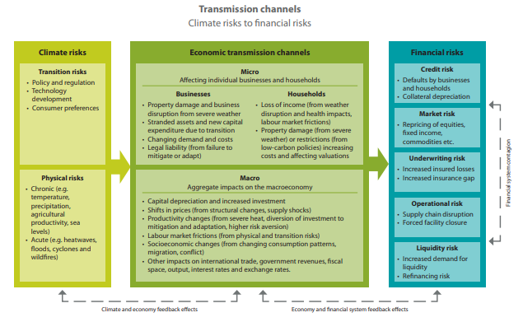
1. Risk management
Source: NGFS, page 9, https://www.ngfs.net/sites/default/files/medias/documents/820184_ngfs_scenarios_final_version_v6.pdf
Notes:
Slide 10
"Climate change poses significant risks to the economy and to the financial system, and while these risks may seem abstract and far away, they are in fact very real, fast approaching, and in need of action today.“
-Sarah Breeden, Executive Director, International Banks Supervision, Bank of England
Climate risk affects the economy and financial system through a range of different transmission channels
Physical and transition risks affect individual businesses and households (e.g. property damage, loss of income, stranded assets), and also have aggregate, macroeconomic impacts (e.g. productivity changes, changes to consumption patterns, increases or decreases in investment).
Financial risks include: credit risk, market risk, underwriting risk, operational risk, liquidity risk.
After the 2008 financial crisis, central banks around the world had a renewed focus on financial stability. Much like with the pandemic today, they sought to identify other risk factors that we might be overlooking, or underestimating, or failing to prepare for, that could lead to generalized, global, financial instability.
Green swans are one such risk. Green swans are climate-related disasters that can have such a wide ranging and extreme impact, that they can cause financial disaster.
Central banks around the world agree that climate change poses a transverse, systemic and interconnected risk that amplifies other business risks and cannot be diversified away.
Society is built on the assumption of a stable climate to model where we should plant crops, where it is safe to build and live, and where to locate critical infrastructure.
With a climate that is stable no longer, models that rely on historic weather patterns are no longer good predictors of future performance.
There is global consensus is that climate change is a financially material business risk:
World economy set to lose up to 18% GDP from climate change if no action taken: ‘The economics of climate change: no action not an option’, SwissRe Institute April 2021.
Canada’s economy could lose up to 9% of GDP – SwissRe Institute Climate Economics Index.
68 of 77 industry subsectors are materially affected by climate risk; this is 89% by market capitalization or US445.1T dollars exposed: ‘Climate risk technical bulletin,’ Sustainability and Accounting Standards Board April 2021.
Office of the Superintendent of Financial Institutions of Canada (OSFI) recognizes that climate-related transition risks can lead to reduced profitability, stranded assets, inability to make loan repayments and/or attract investments, and loss of market capitalization.
Biden’s climate change Executive Order on 27 January 2021 established a process to embed climate risk mitigation in every executive agency of the federal government.
The US Federal Reserve Bank Board of Governors, which for the first time identified climate change as a risk to the American financial system in its Financial Stability Report (Report) of November 2020.
The Network for Greening the Financial System, a consortium of central banks, more frequent or severe extreme weather events and/ or a late and abrupt transition to a low-carbon economy could have significant impacts on the financial system, with potential systemic consequences. Extreme weather events could lead to damage of physical assets, including real estate, productive capital and infrastructure, and loss of life with consequent property and casualty insurance losses, damage to balance sheets of households and firms, increases in defaults, and potential financial sector distress. A late and abrupt transition to a low-carbon economy could lead to a sudden repricing of climate-related risks and stranded assets, which could negatively impact the balance sheets of financial institutions.
Read the full report ‘The Marcoeconomic and Financial Stability Impacts of Climate Change’ June 2020. Available here: https://www.ngfs.net/sites/default/files/medias/documents/ngfs_research_priorities_final.pdf
‘The green swan: Central banking and financial stability in the age of climate change’, Patrick BOLTON - Morgan DESPRES - Luiz Awazu PEREIRA DA SILVA
Frédéric SAMAMA - Romain SVARTZMAN, January 2020 https://www.bis.org/publ/othp31.pdf
Climate change is a material business risk: Taskforce on Climate-Related Financial Disclosures (TCFD), https://www.fsb-tcfd.org/; Sustainability Accounting Standards Board (SASB), https://www.sasb.org/; Principles for Responsible Investing (PRI), https://www.unpri.org/; Global Reporting Initiative (GRI), https://www.globalreporting.org/standards; Canadian Securities Administers (CSA); https://www.securities-administrators.ca/aboutcsa.aspx?id=1833&terms=climate.
“The nature of systemic risk is that it builds over time, is interactive and synergistic and, once in play, is difficult to control”. Climate change is a significant systemic threat facing the stability of the global financial system: ICGN, “Guidance on Investor Fiduciary Duties”, 2018, http://icgn.flpbks.com/icgn-fiduciary_duties/files/extfile/DownloadURL.pdf.

Slide 13
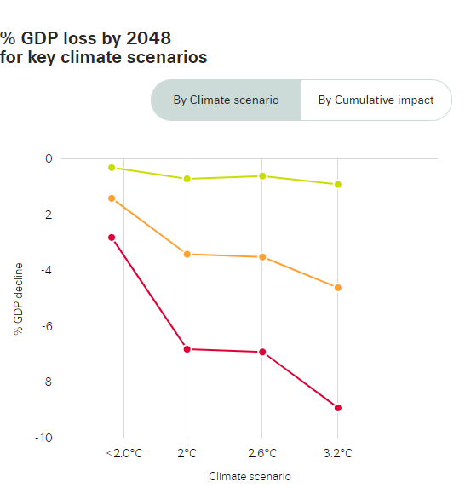

Physical and transition risks are material for most industries
Physical risks can be acute (e.g. increased severity of extreme weather events) or chronic (e.g. related to longer term shifts in climate patterns). Example: withdrawal of insurance for property transactions during wildfire season.
Transition risks relate to policy, legal, technology, market, or reputational risk. Example: action to mitigate physical risk end up changing cost structure for many industries.
Source: SwissRe Institute Climate Economics Index
Notes:
Slide 11
Physical risks can be acute (driven by extreme heat, wildfires, flood, hurricanes) or chronic (related to sea level rise or rising average temperatures), and they cause direct damage to assets, lower yield rates, increase cost of goods sold, etc. This causes economic disruption and losses to the financial system.
Physical risks can disrupt manufacturing operations, supply and distribution chains, damage real estate investments, increase employee illness from heat waves and pollution, and affect different regions in different ways.
In B.C., for example, recent wildfires disrupted pending real estate transactions when insurers withdrew their approval to insure properties due to the risk of damage from the fires (workarounds were possible but transaction were still delayed). See: https://www.trailtimes.ca/news/new-homeowners-living-near-burning-b-c-wildfires-face-tricky-insurance-processes/
Transition risks arise from the transition to a low-carbon economy, and can be driven by changes in consumer and investor preferences, changes in government policies, e.g. carbon pricing, and changes in technology.
Transition risk includes stranded asset risk, due to unanticipated write-downs in carbon-intensive industries. E.g. reduction in carbon-intensive fuel exports due to fluctuations in price and demand from trade partners.
Transition risks include liability risks for failure to disclose material climate risks to investors.
Physical risks resulting from climate change can be event driven (acute) or longer-term shifts (chronic) in climate patterns. Physical risks may have financial implications for organizations, such as direct damage to assets and indirect impacts from supply chain disruption. Organizations’ financial performance may also be affected by changes in water availability, sourcing, and quality; food security; and extreme temperature changes affecting organizations’ premises, operations, supply chain, transport needs, and employee safety. Acute physical risks refer to those that are event-driven, including increased severity of extreme weather events, such as cyclones, hurricanes, or floods. Chronic physical risks refer to longer-term shifts in climate patterns (e.g., sustained higher temperatures) that may cause sea level rise or chronic heat waves; TCFD, Recommendations of the Task Force on Climate-related Financial Disclosures, Final Report, (2017), https://www.fsb-tcfd.org/wp-content/uploads/2017/06/FINAL-2017-TCFD-Report-11052018.pdf.
Due to wildfires in BC, insurers temporarily withheld insurance on new deals, and as a result some real estate sales stalled. See: https://www.trailtimes.ca/news/new-homeowners-living-near-burning-b-c-wildfires-face-tricky-insurance-processes/
Insurance policies could be renewed, but there were instances of insurers halting new policies if a fire was out of control within 50 km. Workarounds exist, including delaying the possession date, or asking the current homeowners to add the new owners to their existing policy. However, the process caused delays to deals.
See notice from Real Estate Council of BC: https://www.recbc.ca/about-us/media/news/information-regarding-bc-wildfires and from BC Real Estate Association: https://www.bcrea.bc.ca/practice-tips/in-a-bind-over-home-insurance/
Earlier years: https://www.canadianunderwriter.ca/insurance/why-your-clients-may-not-be-covered-when-theres-an-active-wildfire-1004163438/ and https://www.cbc.ca/news/canada/british-columbia/bc-wildfires-new-home-insurance-prince-george-1.4206359
CDP: “We believe that improving corporate awareness through measurement and disclosure is essential to the effective management of carbon and climate change risk. We request information on climate risks and low carbon opportunities from the world’s largest companies on behalf of over 515 institutional investor signatories with a combined US $106 trillion in assets and 147 major purchasers with over US $4 trillion in procurement spend.”: Carbon Disclosure Project (CDP), https://www.cdp.net/en/climate.
The Sustainability Accounting Standards Board reports that climate risks affect 89% of US capital markets: SASB Climate Risk Technical Bulletin 2021, https://www.sasb.org/wp-content/uploads/2021/05/Climate-Risk-Technical-Bulletin2021-042821.pdf
International Monetary Fund, Fiscal Monitor: carbon pricing can help countries meet these commitments as it provides the critical price signals for redirecting investment to low-emission technologies. It can also contribute to sustainable macro-fiscal frameworks that are urgently needed for funding social assistance and recovery programs for the present crisis. In many countries, carbon pricing also brings about significant domestic environmental co-benefits such as a reduced mortality rate due to local air pollution; https://www.imf.org/en/Topics/climate-change/.
The Bank of Canada recognizes climate change can affect the ability of central banks to achieve their goals for financial stability and inflation targeting. Two sets of risks are of particular concern: Physical risks from more frequent and severe extreme weather events. These can cause economic disruptions and losses to the financial system. And Transition risks, from the move toward a lower-carbon economy. Sudden or unexpected changes in consumer and investor preferences or in government policies that make pollution more expensive could raise financial system risks. A staff discussion paper in May 2020 outlined illustrative scenarios and the bank is now working with the Office of the Superintendent of Financial Institutions (OSFI) on a pilot project to use climate-change scenarios to better understand the risks to the financial system related to a transition to a net-zero economy. A small group of institutions from the banking and insurance sectors will participate voluntarily in the project.
Read the staff discussion paper here: https://www.bankofcanada.ca/wp-content/uploads/2020/05/sdp2020-3.pdf and news of the pilot project here: https://www.bankofcanada.ca/2020/11/bank-canada-osfi-launch-pilot-project-climate-risk-scenarios/
OSFI, ‘Navigating Uncertainty in Climate Change, Promoting Preparedness and Resilience to Climate-related Risks, (January 2021), 9 <https://www.osfi-bsif.gc.ca/Eng/Docs/clmt-rsk.pdf>
The Basel Committee on Banking Supervision has published a public consultation on principles for the effective management and supervision of climate-related financial risks. https://www.bis.org/bcbs/publ/d530.htm
EU Carbon Boarder Adjustment:
A carbon tax puts a direct price on GHG emissions and requires economic actors to pay for every ton of GHG pollution emitted, creating a financial incentive to lower emissions by switching to more efficient processes or cleaner fuels.
It provides certainty about the price (fixed), but less certainty about reductions.
A cap-and-trade or emissions trading system sets a limit (“cap”) on total GHG emissions and institutes a market where rights to emit (often called “allowances” or “credits”) can be traded.
It provides certainty about emissions reductions (capped), but less certainty about the price of emitting, which fluctuates with the market.
Carbon leakage: an inconsistent patchwork of carbon pricing policies and regulations can result in carbon-intensive industries or firms shifting operations to jurisdictions with a lower carbon price.
Potential solution: Border carbon adjustments or carbon border adjustment mechanism, a form of trade tariff.
Context: President Biden executive actions directly linking climate considerations to national security considerations.
Policy overlap or inconsistency: more effective if designed to be properly aligned with complementary policies like energy efficiency policies, emission performance standards, research/tech policies.
Ineffective use of revenues: revenue deployment issues.
Benefits of emissions trading:
Emissions trading achieves reduced emissions at a lower cost.
The open market sets the price of carbon which leads to better flexibility and avoids price shocks or undue burdens.
Emissions trading incentivizes innovation and identifies lowest-cost solutions to make businesses more sustainable.
Connecting emissions trading systems, as California and Québec have done, widens the pool of participants to trade with, which reduces costs.
Enables unregulated entities (farmers, foresters, entrepreneurs etc.) to become solution providers and generate carbon revenue streams.
The combination of an absolute cap on the level of emissions permitted and the carbon price signal from trading helps businesses to identify low-cost methods of reducing emissions on site, such as investing in energy efficiency.

Slide 14
2. Investment strategy
For corporates:
Cost of capital, activism, and trade
For investors:
Evaluating exposure and collective action
Lenders are committing to net-zero emissions in lending by 2050; Vancity is a signatory to the Net-Zero Banking Alliance and has set a deadline of 2040.
Investors are asking for data on climate risk, and seeking out sustainable investment options (e.g. Blackrock, CDPQ).
Green bond issuance has passed the $1 trillion mark.
Trade: Canada and U.S. are considering border carbon adjustments to preserve competitiveness. EDC strengthened its climate lens.
Shareholder activism, including proposals on environmental matters and ‘Say on Climate’ votes, have increased (e.g. Exxon, Chevron).
ESG factors associated with improved long-term, risk-adjusted returns.
Green taxonomies shaping the market (e.g. EU Taxonomy, CFA Standards).
Investing for sustainability impact approaches, where considered effective in achieving investors financial goals, investor could be legally required or permitted to consider using them (Freshfields report).
Collective action: Pension funds and other institutional investors are committing to net-zero by 2050, and working collectively to ask for credible, consistent and comparable data on climate risks, impacts and actions (e.g. CA100+, Climate Engagement Canada).
Notes:
Slide 12
Corporates
Carbon emissions are a proxy for climate risk because emissions today contribute to increasing physical risks in the medium and long term, and emissions are also an estimate of exposure to transition risk associated with an increasing price on carbon, in the short term.
In order to identify, quantify, evaluate, and mitigate climate risk, and to better finance a green transition, investors and lenders are seeking more consistent, comparable and credible data on carbon emissions and other climate risk metrics, such as climate value at risk.
Over 100 financial institutions have joined the Partnership for Carbon Accounting Financials (PCAF) which creates standards to assess and disclose greenhouse gas emissions of loans and investments: https://carbonaccountingfinancials.com/
Investors are also showing a growing appetite for sustainable investments. Global sustainable investment reached USD35.3 trillion in five major markets in 2020, a 15% increase in the past two years (2018-2020). Source: 2020 Global Sustainable Investment Review.
In September 2020, more than $50 billion in green bonds were sold, and by October 2020, the green bond issuance reached the $1trillion mark in total issuance. Source: Climate Bonds Initiative.
Canada, U.S., and others are considering border carbon adjustments in order to address the issue of carbon ‘leakage’ and remain competitive with countries that may have a lower or no price on carbon.
Investors are also taking action via climate-related engagement and shareholder proposals e.g. in a “Say on Climate” vote, the shareholders vote on their company’s climate policies.
Savvy companies can attract capital from responsible investors that are seeking to invest in low-carbon solutions to counter the impact of global trends such as rapid urbanization, water and food scarcity, extreme weather. Companies can move strategically to create value over short, medium and long term, and as they transition, engaging in a thorough discussion about risks, disruptors and upside opportunities for the company.
Investors
Companies that focus on ESG factors have performed better and shown resilience. ESG funds have been shown to outperform the market.
The EU Green Taxonomy creates a common language and uniform criteria for “green” and “sustainable” economic activities that is shaping the market because even non-EU funds may face pressure by EU-based or other ESG-minded investors to disclose the percentage of investments that are aligned with the EU Taxonomy.
Canada’s largest banks, insurance companies and pension funds are currently funding development of a “made-in-Canada” transition-finance taxonomy to form the basis both of a Canadian standard in 2021 and of Canada’s participation in formulating a new ISO Sustainable Finance Standard.
Climate-related activities within finance fall somewhere along the spectrum between aligning investment activity with climate goals and managing climate-related risks, and current forms of sustainable investing focus on integrating sustainability factors into investment decisions. However, UNPRI has commissioned a report by Freshfields, Bruckhaus, Deringer LLP clarifies that that investors can intentionally seek to influence what their investee companies do, in an assessable way, to address sustainability challenges.
And there is a legal ‘cascade effect’ from Asset Owners to all those who directly or indirectly provide services to them.
Investors have joined together in collective action to engage with companies and seek climate-related data.
Examples of investors seeking climate-related data:
Investors are starting to look at and to expect information on companies’ strategic planning and business plan to address climate change, for example, Institutional Investors Group on Climate Change (IIGCC), Net Zero Investment Framework (8 August 2020), https://www.iigcc.org/resource/net-zero-investment-framework-for-consultation/)
Larry Fink’s 2021 letter to CEOs asks companies to disclose a plan for how their business model will be compatible with a net-zero economy – that is, one where global warming is limited to well below 2ºC, consistent with a global aspiration of net zero greenhouse gas emissions by 2050. They must disclose how this plan is incorporated into long-term strategy and reviewed by the board of directors. Read the full letter here: https://www.blackrock.com/corporate/investor-relations/larry-fink-ceo-letter
Caisse de dépôt et placement du Québec (CDPQ) announced its new climate strategy on September 28th, 2022. Building on its accomplishments since 2017, it wants to increase its ambitions. 1) Hold %54 billion in green assets by 2025. 2) Achieve 60% reduction in the carbon intensity of the total portfolio by 2030. 3) Create a $10 billion transition envelope to decarbonize the main industrial carbon-emitting sectors. 4) Complete its exit from oil production by the end of 2022. It has invested more than $10 billion in low-carbon investments, with $34 billion investment in low-carbon assets as of December 2019, up 95% over 2017. It has reduced its portfolio’s carbon intensity by 10% since 2017, on track to its target of a 25% reduction by 2025. It is aligning compensation of portfolio managers to reaching targets (CDPQ 2020). It factors climate change into every investment decision; increase its low-­carbon investments by 80% between 2017 and 2020; and Exercise stronger climate leadership within the industry and with our portfolio companies; CDPQ, “2019 Stewardship Investing Report”, (2020), https://www.cdpq.com/sites/default/files/medias/pdf/en/ra/id2019_rapport_investissement_durable_en.pdf.
Examples of recent shareholder activism:
98% of General Electric shareholders voted for a proposal seeking details of how the company will achieve net-zero emissions across its operations and products. https://www.forbes.com/sites/mindylubber/2021/05/14/why-this-proxy-season-is-a-record-breaker-for-climate-proposals/?sh=2e1b984e54d4
99% of Bunge Ltd shareholders voted to ask the company for a stronger no deforestation policy. https://news.bloomberglaw.com/bloomberg-law-analysis/analysis-deforestation-shareholder-proposal-wins-signal-a-shift
81% of DuPont shareholders voted to seek a stronger plastics pollution policy and disclosure on how much plastic the company releases into the environment. https://www.bloomberg.com/news/articles/2021-05-03/dupont-loses-plastic-pollution-vote-with-record-81-rebellion
58% of ConocoPhillips shareholders approved a measure asking the oil company to go beyond reducing part of its emissions to cutting them to net-zero. https://www.reuters.com/business/environment/conocophillips-shareholders-back-proposal-set-scope-3-targets-2021-05-11/#:~:text=ConocoPhillips%20is%20among%20those%20that,shareholder%20measure%20passed%20by%2058%25.
A majority of Phillips66 shareholders voted to ask the company to set emissions reductions targets as well as for a proposal seeking a report on how Phillips66’ lobbying aligns with the goals of the Paris Agreement. https://share.ca/phillips-66-climate-lobbying/
A majority of Chevron shareholders voted 61% in favour of an activist proposal from Dutch campaign group Follow This, to force the group to cut its carbon emissions. https://www.theguardian.com/business/2021/may/26/exxonmobil-and-chevron-braced-for-showdown-over-climate
ExxonMobil failed to defend its board against a coup launched by dissident hedge fund activists at Engine No. 1 which successfully replaced two Exxon board members with its own candidates to help drive the oil company towards a greener strategy. https://www.nytimes.com/2021/05/26/business/exxon-mobil-climate-change.html
Many investors have preferred engaging with companies: of the 115 environmental proposals submitted, over half (70 total) were withdrawn (compared to 39 in 2020). The submitted environmental proposals that did go to a vote received greater shareholder support (an average of 41% of votes cast compared to 32% in 2020). https://corpgov.law.harvard.edu/2021/08/11/2021-proxy-season-review-shareholder-proposals-on-environmental-matters/
In a “Say on Climate” vote, the shareholders vote on their company’s climate policies with three core components. First, companies must disclose their greenhouse gas (“GHG”) emissions consistent with recommendations of the Task Force on Climate-related Financial Disclosures (“TCFD”), an international body established by G20 leaders to improve the efficiency of these disclosures. Second, they must disclose a plan to manage those emissions. Third, companies must provide shareholders with an advisory vote on the plan and performance relative to such plan at their annual general meetings (“AGMs”). https://mcmillan.ca/insights/say-on-climate-key-considerations-in-implementing-shareholder-votes-on-climate/
Examples of ESG fund performance and growth:
In the first half of 2020, ESG index funds outperformed their conventional index-fund counterparts and 23 new sustainable funds were launched (Morningstar, 2020: “ESG Funds Setting a Record Pace for Launches in 2020” (24 June 2020), Morningstar, https://www.morningstar.com/articles/989209/esg-funds-setting-a-record-pace-for-launches-in-2020
At the start of 2020, global sustainable investment reached USD35.3 trillion in five major markets, a 15% increase in the past two years (2018-2020). Sustainable investment assets under management make up a total of 35.9% of total assets under management, up from 33.4% in 2018.
2020 Global Sustainable Investment Review http://www.gsi-alliance.org/wp-content/uploads/2021/08/GSIR-20201.pdf
Examples of collective action by shareholders:
Climate Action 100+ investors (nearly 600 firms responsible for $54 trillion or half the world’s managed assets) engage with large emitters to achieve the goals of the Paris Agreement and implement the recommendations of the Taskforce on Climate-related Financial Disclosures (TCFD).
Signatories have agreed there should be a broad common engagement agenda across sectors, regions and business types and seek commitments from boards and senior management to:
Implement a strong governance framework which clearly articulates the board’s accountability and oversight of climate change risk;
Take action to reduce greenhouse gas emissions across the value chain, consistent with the Paris Agreement’s goal of limiting global average temperature increase to well below two degrees Celsius above pre-industrial levels, aiming for 1.5 degrees. Notably, this implies the need to move towards net-zero emissions by 2050 or sooner. The first entrant recently moved to a “net-zero 2050” benchmark; and
Provide enhanced corporate disclosure in line with the final recommendations of the Task Force on Climate‑related Financial Disclosures (TCFD) and sector-specific Global Investor Coalition on Climate Change (GIC) Investor Expectations on Climate Change guidelines (when applicable), to enable investors to assess the robustness of companies’ business plans against a range of climate scenarios, including well below two degrees and improve investment decision-making.
An important component of company commitments on climate change is the formation of comprehensive business strategies that fully align with the goals of the Paris Agreement and reaching net-zero emissions by 2050 or sooner. These strategies would encompass and actualise the three asks of the initiative in core business decisions of a focus company.
https://www.climateaction100.org/approach/the-three-asks/
Canadian university endowments and pension plans are working with SHARE to engage investee companies on climate risk through the University Network for Investor Engagement (UNIE)
The Canadian Coalition for Good Governance ("CCGG“, representing 53 Canadian institutional investors managing $4.5 trillion of assets), supports the TCFD framework, the first time that CCGG has formally recognized a third-party framework as a best practice.
Climate Engagement Canada: Includes 29 institutional investors,with $3.6 trillion in AUM. CEC has a similar objective like Climate Action 100+, but it’s a local effort.
CEOs of eight Canadian pension plans called on companies to measure and disclose ESG performance on material, industry-relevant factors, leveraging SASB and TCFD.
See the joint statement from the CEOs of AIMCo, BCi, CDPQ, CPP, HOOPP, OMERS, Ontario Teachers and PSP: https://cdn3.cppinvestments.com/wp-content/uploads/2020/11/CEO-Statement-CEO-Signatures-EN-Nov25-2020.pdf
Glasgow Financial Alliance for Net-Zero: “GFANZ firms’ net-zero commitments must use science-based guidelines to reach net-zero emissions by 2050, cover all emission scopes, include 2030 interim target settings and commit to transparent reporting and accounting in line with Race to Zero criteria. GFANZ members have $120 trillion AUM, many of which are banks. The initiative seeks to address tensions between parts of the investment value chain.
A Freshfields / UNPRI report found that while there are differences across jurisdictions and investor groups, where investing for sustainability impact approaches can be effective in achieving an investor’s financial goals, the investor will likely be required to consider using them and act accordingly. Financial return is commonly the primary goal of institutional investors, so the situation is most clear where a sustainability risk bears on investors’ duties to pursue financial goals. Here, where sustainability impact approaches can be effective in achieving an investor’s goals, the investor will likely be required to consider using them and act accordingly. However, there are differences of understanding and uncertainties. Cases where investors can pursue sustainability goals for their own sake in parallel with financial goals are more limited, but there are instances in most jurisdictions, usually subject to prioritizing financial goals. The legal duties and discretions that apply to Asset Owners in managing their assets are key to the analysis. But what these require or permit is not just relevant to them; it also shapes the obligations and discretions of investment managers and others who assist Asset Owners in managing their assets. For example, to discharge their own legal duties, investment consultants need to understand the Asset Owner’s duties and discretions to decide how best to advise. In other words, there is a legal ‘cascade effect’ from Asset Owners to all those who directly or indirectly provide services to them.
A LEGAL FRAMEWORK FOR IMPACT: SUSTAINABILITY IMPACT IN INVESTOR DECISION-MAKING
See also:
ARC Energy Podcast on the ESG Movement:
https://www.arcenergyinstitute.com/why-you-cant-ignore-the-esg-movement/.
Oxford University: Corporate sustainability and profitability are interrelated: https://sustaincase.com/oxford-university-corporate-sustainability-and-profitability-are-interrelated/.
14.4% of the Canadian economy is tied to the extraction, refining, transport and sale of oil, gas, and coal. These sectors are vulnerable as global investors move to disinvest/reinvest in renewables. Largest greenhouse gas (GHG) emitting sectors in Canada: Oil & Gas 27%; Transportation 24%, signaling the need for significant investment to transition to a low-carbon economy.
https://www.capp.ca/explore/greenhouse-gas-emissions/
Canada Expert Panel on Sustainable Finance: “There is a clear and urgent imperative for governments, businesses and the financial community to work together to make deep emissions cuts in virtually every sector”: Final Report 2019, http://publications.gc.ca/collections/collection_2019/eccc/En4-350-2-2019-eng.pdf.
Examples of the increasing cost of capital if boards fail to act include the cost of borrowing in terms of interest rates and availability; the cost and/or availability of insurance; the cost of financial products (swaps and other derivatives) to hedge risk; and the ability to attract and retain equity investors.
A growing number of empirical studies conclude that companies that develop organizational processes to measure, manage and communicate performance on ESG issues, including climate change, outperform and have higher financial returns than control groups of companies, in some cases by 40%: G. Friede, T. Busch & A. Bassen, “ESG and financial performance: aggregated evidence from more than 2000 empirical studies”: https://www.tandfonline.com/doi/full/10.1080/20430795.2015.1118917.
Shifts in investor preferences will increase the cost of capital for companies that cannot demonstrate appropriate attention to climate-related issues, as evidenced by recent Scotia ESG Investment Research report, https://scotia.bluematrix.com/docs/pdf/d3087800-c78d-42a6-b8e8-05010fe7af50.pdf.
The government of Canada published its Green Bond Framework on March 3rd, 2022, in advance of an inaugural green bond issuance of $5 billion in fiscal year 2021-2022. The framework defines eligibility criteria and provides example expenditures aligned with the International Capital Markets Association Green Bond Principles in nine areas, including clean translation, energy efficiency, climate change adaptation, etc. https://www.canada.ca/en/department-finance/news/2022/03/canada-publishes-green-bond-framework-in-advance-of-inaugural-issuance.html
Shareholder activism:
Characteristics of past resolutions on climate (circa 2010-2014):
Focused on environmental impact.
Requested reporting or discrete actions.
Maxed out at 20-30% support (which was sometimes enough for corporate behavioral change).
Primary focus on additional disclosure, but in a range of areas:
Capital spending,
Governance and controls,
Climate plans,
Remuneration
Lobbying
Challenges to governance of risk:
Climate competent boards
Remuneration and financial incentives for growth
Lobbying:
Whether formal lobbying, political spending, or trade association membership.

Slide 15

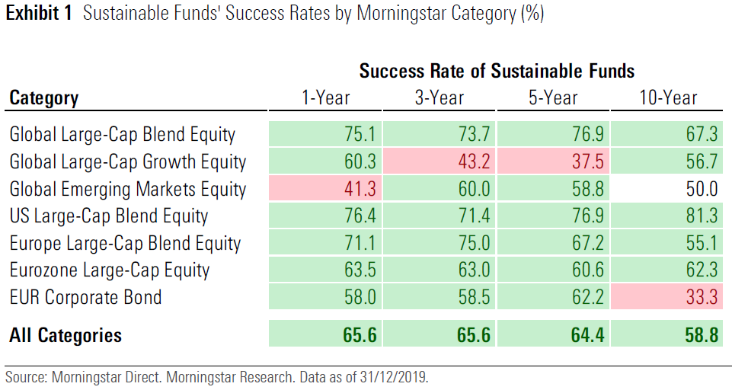
2. Investment strategy
Average returns and success rates for sustainable funds across seven Morningstar Categories suggest that there is no performance trade-off associated with sustainable funds. In fact, a majority of sustainable funds have outperformed their traditional peers over multiple time horizons.
Over the 10 years through 2019, nearly 50% of surviving sustainable funds across the categories considered have beaten their average surviving traditional counterpart.
Sustainable funds held up better than their traditional counterparts during the COVID-19 sell-off, delivering superior returns in all but one category.
Notes:
Slide 12
Corporates
Carbon emissions are a proxy for climate risk because emissions today contribute to increasing physical risks in the medium and long term, and emissions are also an estimate of exposure to transition risk associated with an increasing price on carbon, in the short term.
In order to identify, quantify, evaluate, and mitigate climate risk, and to better finance a green transition, investors and lenders are seeking more consistent, comparable and credible data on carbon emissions and other climate risk metrics, such as climate value at risk.
Over 100 financial institutions have joined the Partnership for Carbon Accounting Financials (PCAF) which creates standards to assess and disclose greenhouse gas emissions of loans and investments: https://carbonaccountingfinancials.com/
Investors are also showing a growing appetite for sustainable investments. Global sustainable investment reached USD35.3 trillion in five major markets in 2020, a 15% increase in the past two years (2018-2020). Source: 2020 Global Sustainable Investment Review.
In September 2020, more than $50 billion in green bonds were sold, and by October 2020, the green bond issuance reached the $1trillion mark in total issuance. Source: Climate Bonds Initiative.
Canada, U.S., and others are considering border carbon adjustments in order to address the issue of carbon ‘leakage’ and remain competitive with countries that may have a lower or no price on carbon.
Investors are also taking action via climate-related engagement and shareholder proposals e.g. in a “Say on Climate” vote, the shareholders vote on their company’s climate policies.
Savvy companies can attract capital from responsible investors that are seeking to invest in low-carbon solutions to counter the impact of global trends such as rapid urbanization, water and food scarcity, extreme weather. Companies can move strategically to create value over short, medium and long term, and as they transition, engaging in a thorough discussion about risks, disruptors and upside opportunities for the company.
Investors
Companies that focus on ESG factors have performed better and shown resilience. ESG funds have been shown to outperform the market.
The EU Green Taxonomy creates a common language and uniform criteria for “green” and “sustainable” economic activities that is shaping the market because even non-EU funds may face pressure by EU-based or other ESG-minded investors to disclose the percentage of investments that are aligned with the EU Taxonomy.
Canada’s largest banks, insurance companies and pension funds are currently funding development of a “made-in-Canada” transition-finance taxonomy to form the basis both of a Canadian standard in 2021 and of Canada’s participation in formulating a new ISO Sustainable Finance Standard.
Climate-related activities within finance fall somewhere along the spectrum between aligning investment activity with climate goals and managing climate-related risks, and current forms of sustainable investing focus on integrating sustainability factors into investment decisions. However, UNPRI has commissioned a report by Freshfields, Bruckhaus, Deringer LLP clarifies that that investors can intentionally seek to influence what their investee companies do, in an assessable way, to address sustainability challenges.
And there is a legal ‘cascade effect’ from Asset Owners to all those who directly or indirectly provide services to them.
Investors have joined together in collective action to engage with companies and seek climate-related data.
Examples of investors seeking climate-related data:
Investors are starting to look at and to expect information on companies’ strategic planning and business plan to address climate change, for example, Institutional Investors Group on Climate Change (IIGCC), Net Zero Investment Framework (8 August 2020), https://www.iigcc.org/resource/net-zero-investment-framework-for-consultation/)
Larry Fink’s 2021 letter to CEOs asks companies to disclose a plan for how their business model will be compatible with a net-zero economy – that is, one where global warming is limited to well below 2ºC, consistent with a global aspiration of net zero greenhouse gas emissions by 2050. They must disclose how this plan is incorporated into long-term strategy and reviewed by the board of directors. Read the full letter here: https://www.blackrock.com/corporate/investor-relations/larry-fink-ceo-letter
Caisse de dépôt et placement du Québec (CDPQ) announced its new climate strategy on September 28th, 2022. Building on its accomplishments since 2017, it wants to increase its ambitions. 1) Hold %54 billion in green assets by 2025. 2) Achieve 60% reduction in the carbon intensity of the total portfolio by 2030. 3) Create a $10 billion transition envelope to decarbonize the main industrial carbon-emitting sectors. 4) Complete its exit from oil production by the end of 2022. It has invested more than $10 billion in low-carbon investments, with $34 billion investment in low-carbon assets as of December 2019, up 95% over 2017. It has reduced its portfolio’s carbon intensity by 10% since 2017, on track to its target of a 25% reduction by 2025. It is aligning compensation of portfolio managers to reaching targets (CDPQ 2020). It factors climate change into every investment decision; increase its low-­carbon investments by 80% between 2017 and 2020; and Exercise stronger climate leadership within the industry and with our portfolio companies; CDPQ, “2019 Stewardship Investing Report”, (2020), https://www.cdpq.com/sites/default/files/medias/pdf/en/ra/id2019_rapport_investissement_durable_en.pdf.
Examples of recent shareholder activism:
98% of General Electric shareholders voted for a proposal seeking details of how the company will achieve net-zero emissions across its operations and products. https://www.forbes.com/sites/mindylubber/2021/05/14/why-this-proxy-season-is-a-record-breaker-for-climate-proposals/?sh=2e1b984e54d4
99% of Bunge Ltd shareholders voted to ask the company for a stronger no deforestation policy. https://news.bloomberglaw.com/bloomberg-law-analysis/analysis-deforestation-shareholder-proposal-wins-signal-a-shift
81% of DuPont shareholders voted to seek a stronger plastics pollution policy and disclosure on how much plastic the company releases into the environment. https://www.bloomberg.com/news/articles/2021-05-03/dupont-loses-plastic-pollution-vote-with-record-81-rebellion
58% of ConocoPhillips shareholders approved a measure asking the oil company to go beyond reducing part of its emissions to cutting them to net-zero. https://www.reuters.com/business/environment/conocophillips-shareholders-back-proposal-set-scope-3-targets-2021-05-11/#:~:text=ConocoPhillips%20is%20among%20those%20that,shareholder%20measure%20passed%20by%2058%25.
A majority of Phillips66 shareholders voted to ask the company to set emissions reductions targets as well as for a proposal seeking a report on how Phillips66’ lobbying aligns with the goals of the Paris Agreement. https://share.ca/phillips-66-climate-lobbying/
A majority of Chevron shareholders voted 61% in favour of an activist proposal from Dutch campaign group Follow This, to force the group to cut its carbon emissions. https://www.theguardian.com/business/2021/may/26/exxonmobil-and-chevron-braced-for-showdown-over-climate
ExxonMobil failed to defend its board against a coup launched by dissident hedge fund activists at Engine No. 1 which successfully replaced two Exxon board members with its own candidates to help drive the oil company towards a greener strategy. https://www.nytimes.com/2021/05/26/business/exxon-mobil-climate-change.html
Many investors have preferred engaging with companies: of the 115 environmental proposals submitted, over half (70 total) were withdrawn (compared to 39 in 2020). The submitted environmental proposals that did go to a vote received greater shareholder support (an average of 41% of votes cast compared to 32% in 2020). https://corpgov.law.harvard.edu/2021/08/11/2021-proxy-season-review-shareholder-proposals-on-environmental-matters/
In a “Say on Climate” vote, the shareholders vote on their company’s climate policies with three core components. First, companies must disclose their greenhouse gas (“GHG”) emissions consistent with recommendations of the Task Force on Climate-related Financial Disclosures (“TCFD”), an international body established by G20 leaders to improve the efficiency of these disclosures. Second, they must disclose a plan to manage those emissions. Third, companies must provide shareholders with an advisory vote on the plan and performance relative to such plan at their annual general meetings (“AGMs”). https://mcmillan.ca/insights/say-on-climate-key-considerations-in-implementing-shareholder-votes-on-climate/
Examples of ESG fund performance and growth:
In the first half of 2020, ESG index funds outperformed their conventional index-fund counterparts and 23 new sustainable funds were launched (Morningstar, 2020: “ESG Funds Setting a Record Pace for Launches in 2020” (24 June 2020), Morningstar, https://www.morningstar.com/articles/989209/esg-funds-setting-a-record-pace-for-launches-in-2020
At the start of 2020, global sustainable investment reached USD35.3 trillion in five major markets, a 15% increase in the past two years (2018-2020). Sustainable investment assets under management make up a total of 35.9% of total assets under management, up from 33.4% in 2018.
2020 Global Sustainable Investment Review http://www.gsi-alliance.org/wp-content/uploads/2021/08/GSIR-20201.pdf
Examples of collective action by shareholders:
Climate Action 100+ investors (nearly 600 firms responsible for $54 trillion or half the world’s managed assets) engage with large emitters to achieve the goals of the Paris Agreement and implement the recommendations of the Taskforce on Climate-related Financial Disclosures (TCFD).
Signatories have agreed there should be a broad common engagement agenda across sectors, regions and business types and seek commitments from boards and senior management to:
Implement a strong governance framework which clearly articulates the board’s accountability and oversight of climate change risk;
Take action to reduce greenhouse gas emissions across the value chain, consistent with the Paris Agreement’s goal of limiting global average temperature increase to well below two degrees Celsius above pre-industrial levels, aiming for 1.5 degrees. Notably, this implies the need to move towards net-zero emissions by 2050 or sooner. The first entrant recently moved to a “net-zero 2050” benchmark; and
Provide enhanced corporate disclosure in line with the final recommendations of the Task Force on Climate‑related Financial Disclosures (TCFD) and sector-specific Global Investor Coalition on Climate Change (GIC) Investor Expectations on Climate Change guidelines (when applicable), to enable investors to assess the robustness of companies’ business plans against a range of climate scenarios, including well below two degrees and improve investment decision-making.
An important component of company commitments on climate change is the formation of comprehensive business strategies that fully align with the goals of the Paris Agreement and reaching net-zero emissions by 2050 or sooner. These strategies would encompass and actualise the three asks of the initiative in core business decisions of a focus company.
https://www.climateaction100.org/approach/the-three-asks/
Canadian university endowments and pension plans are working with SHARE to engage investee companies on climate risk through the University Network for Investor Engagement (UNIE)
The Canadian Coalition for Good Governance ("CCGG“, representing 53 Canadian institutional investors managing $4.5 trillion of assets), supports the TCFD framework, the first time that CCGG has formally recognized a third-party framework as a best practice.
Climate Engagement Canada: Includes 29 institutional investors,with $3.6 trillion in AUM. CEC has a similar objective like Climate Action 100+, but it’s a local effort.
CEOs of eight Canadian pension plans called on companies to measure and disclose ESG performance on material, industry-relevant factors, leveraging SASB and TCFD.
See the joint statement from the CEOs of AIMCo, BCi, CDPQ, CPP, HOOPP, OMERS, Ontario Teachers and PSP: https://cdn3.cppinvestments.com/wp-content/uploads/2020/11/CEO-Statement-CEO-Signatures-EN-Nov25-2020.pdf
Glasgow Financial Alliance for Net-Zero: “GFANZ firms’ net-zero commitments must use science-based guidelines to reach net-zero emissions by 2050, cover all emission scopes, include 2030 interim target settings and commit to transparent reporting and accounting in line with Race to Zero criteria. GFANZ members have $120 trillion AUM, many of which are banks. The initiative seeks to address tensions between parts of the investment value chain.
A Freshfields / UNPRI report found that while there are differences across jurisdictions and investor groups, where investing for sustainability impact approaches can be effective in achieving an investor’s financial goals, the investor will likely be required to consider using them and act accordingly. Financial return is commonly the primary goal of institutional investors, so the situation is most clear where a sustainability risk bears on investors’ duties to pursue financial goals. Here, where sustainability impact approaches can be effective in achieving an investor’s goals, the investor will likely be required to consider using them and act accordingly. However, there are differences of understanding and uncertainties. Cases where investors can pursue sustainability goals for their own sake in parallel with financial goals are more limited, but there are instances in most jurisdictions, usually subject to prioritizing financial goals. The legal duties and discretions that apply to Asset Owners in managing their assets are key to the analysis. But what these require or permit is not just relevant to them; it also shapes the obligations and discretions of investment managers and others who assist Asset Owners in managing their assets. For example, to discharge their own legal duties, investment consultants need to understand the Asset Owner’s duties and discretions to decide how best to advise. In other words, there is a legal ‘cascade effect’ from Asset Owners to all those who directly or indirectly provide services to them.
A LEGAL FRAMEWORK FOR IMPACT: SUSTAINABILITY IMPACT IN INVESTOR DECISION-MAKING
See also:
ARC Energy Podcast on the ESG Movement:
https://www.arcenergyinstitute.com/why-you-cant-ignore-the-esg-movement/.
Oxford University: Corporate sustainability and profitability are interrelated: https://sustaincase.com/oxford-university-corporate-sustainability-and-profitability-are-interrelated/.
14.4% of the Canadian economy is tied to the extraction, refining, transport and sale of oil, gas, and coal. These sectors are vulnerable as global investors move to disinvest/reinvest in renewables. Largest greenhouse gas (GHG) emitting sectors in Canada: Oil & Gas 27%; Transportation 24%, signaling the need for significant investment to transition to a low-carbon economy.
https://www.capp.ca/explore/greenhouse-gas-emissions/
Canada Expert Panel on Sustainable Finance: “There is a clear and urgent imperative for governments, businesses and the financial community to work together to make deep emissions cuts in virtually every sector”: Final Report 2019, http://publications.gc.ca/collections/collection_2019/eccc/En4-350-2-2019-eng.pdf.
Examples of the increasing cost of capital if boards fail to act include the cost of borrowing in terms of interest rates and availability; the cost and/or availability of insurance; the cost of financial products (swaps and other derivatives) to hedge risk; and the ability to attract and retain equity investors.
A growing number of empirical studies conclude that companies that develop organizational processes to measure, manage and communicate performance on ESG issues, including climate change, outperform and have higher financial returns than control groups of companies, in some cases by 40%: G. Friede, T. Busch & A. Bassen, “ESG and financial performance: aggregated evidence from more than 2000 empirical studies”: https://www.tandfonline.com/doi/full/10.1080/20430795.2015.1118917.
Shifts in investor preferences will increase the cost of capital for companies that cannot demonstrate appropriate attention to climate-related issues, as evidenced by recent Scotia ESG Investment Research report, https://scotia.bluematrix.com/docs/pdf/d3087800-c78d-42a6-b8e8-05010fe7af50.pdf.
The government of Canada published its Green Bond Framework on March 3rd, 2022, in advance of an inaugural green bond issuance of $5 billion in fiscal year 2021-2022. The framework defines eligibility criteria and provides example expenditures aligned with the International Capital Markets Association Green Bond Principles in nine areas, including clean translation, energy efficiency, climate change adaptation, etc. https://www.canada.ca/en/department-finance/news/2022/03/canada-publishes-green-bond-framework-in-advance-of-inaugural-issuance.html
Shareholder activism:
Characteristics of past resolutions on climate (circa 2010-2014):
Focused on environmental impact.
Requested reporting or discrete actions.
Maxed out at 20-30% support (which was sometimes enough for corporate behavioral change).
Primary focus on additional disclosure, but in a range of areas:
Capital spending,
Governance and controls,
Climate plans,
Remuneration
Lobbying
Challenges to governance of risk:
Climate competent boards
Remuneration and financial incentives for growth
Lobbying:
Whether formal lobbying, political spending, or trade association membership.

Slide 16
A note on ESG and climate
There is a history to the ESG movement that is important to know to understand how ESG and climate will be brought to a trustee table.
  See K. Skerrett et al, Contradictions of Pension Fund Capitalism
  A basic question: is ESG a social movement/priority, or a marketing development by asset managers?
Technically, climate matters are a sub-category of ESG, in the “E” field
However, climate matters are distinct from the treatment of other ESG factors in that, there is just zero doubt that climate change is a material risk to all assets in all funds everywhere, and in fact, as previously suggested, is a public policy problem that is not solvable through market asset allocation decisions
Some basic observations:
  ESG is a highly contested set of proposals and concepts
  Has proven to be very manipulable
  ESG and climate each have become areas for a significant amount of misrepresentation and virtue signalling, e.g., “greenwashing”

Slide 17
3. Staying ahead of changing regulations
Courts recognize the significance of climate change
Canada is committed to net-zero emissions by 2050
Saskatchewan Court of Appeal and Court of Appeal for Ontario: “human-caused climate change poses an existential threat”.
Alberta Court of Appeal: “The dangers of climate change are undoubted, as are the risks flowing from failure to meet the essential challenge.”
Supreme Court held that the References re Greenhouse Gas Pollution Pricing Act, 2021 SCC 11 is constitutionally valid legislation.
Canada’s Net Zero Emissions Accountability Act establishes 5-year carbon budgets towards net-zero emissions by 2050.
Canadian securities regulators are clear
Federal regulators acknowledge risk to Canadian economy
Canadian Securities Administrators (CSA), Proposed National Instrument 51-107 Disclosure of Climate-related Matters, 2021: The CSA proposed climate-related disclosure requirements for corporate issuers aligned with TCFD recommendations.
Bank of Canada’s 2019 Financial System Review, reports climate change as a vulnerability to Canada’s economy and financial system.
Notes:
Slide 13
Canadian courts on climate change:
Supreme Court of Canada acknowledged “that climate change is an existential challenge”, that it is “a threat of the highest order to the country, and indeed to the world”, and that carbon pricing is of significant importance in national and international efforts to reduce greenhouse gas emissions to address climate change.
As part of the reference, every government in Canada has agreed that climate change is real and poses existential threats. GHG Reference, 2021.
Saskatchewan Court of Appeal and Court of Appeal for Ontario: “human-caused climate change poses an existential threat”. Reference re Greenhouse Gas Pollution Pricing Act, 2019 SKCA 40; Reference re Greenhouse Gas Pollution Pricing Act, 2019 ONCA 544.
The Alberta Court of Appeal: “The dangers of climate change are undoubted as are the risks flowing from failure to meet the essential challenge. Equally, it is undisputed that greenhouse gas emissions caused by people (GHG emissions) are a cause of climate change.” Reference re Greenhouse Gas Pollution Pricing Act, 2020 ABCA 74, at para 1.
Net-zero regulation:
Canada’s Net Zero Emissions Accountability Act (Canadian Net-Zero Emissions Accountability Act, SC 2021, c 22) establishes a legal foundation to achieve net-zero emissions by 2050, with statutory 5-year carbon budgets and impact reports.
Read more Canadian Net-Zero Emissions Accountability Act, SC 2021, c 22 first reading: https://parl.ca/DocumentViewer/en/43-2/bill/C-12/first-reading and ‘A new Canadian Climate Accountability Act – detailed report’, May 2020, EcoJustice. Full report available here: https://www.ecojustice.ca/wp-content/uploads/2020/06/A-New-Canadian-Climate-Accountability-Act-Detailed-Report-1.pdf
As part of the Paris Agreement, Canada has committed to reducing its GHG emissions to 30% below 2005 levels by 2030, which will also have financial implications. Canada is committed to net zero carbon emissions by 2050, Prime Minister Justin Trudeau, Minister of Environment and Climate Change Mandate Letter, (13 December 2019), https://pm.gc.ca/en/mandate-letters/2019/12/13/minister-environment-and-climate-change-mandate-letter. See also Canadian Institute for Climate Choices, “Getting to zero: Canada plans to hit net-zero emissions by 2050. What’s next?”, (21 January 2020), https://climatechoices.ca/getting-to-zero-canada-plans-to-hit-net-zero-emissions-by-2050-whats-next/.
Securities regulators on climate disclosure:
CSA Staff Notice 51-358 Reporting of Climate Change-related Risks, 1 August 2019, https://www.osc.gov.on.ca/en/SecuritiesLaw_csa_20190801_51-358_reporting-of-climate-change-related-risks.htm
It reinforces and expands upon the guidance provided in CSA Staff Notice 51-333 Environmental Reporting Guidance and should be read in conjunction with it.
It poses the following questions for boards to ask themselves:
Is the board provided with appropriate orientation and information to help members understand sector specific climate change-related issues?
Has the board been provided sufficient information, including management’s materiality assessments in respect of the issuer’s climate change-related risks, to appropriately oversee and consider management’s assessment of these risks?
Is the board comfortable with the methodology used by management to capture the nature of climate change-related risks and assess the materiality of such risks?
Is the board aware of how their investors are factoring climate change-related risks into their investment and voting decisions?
Is oversight and management of climate change-related risks and opportunities integrated into the issuer’s strategic plan, and if so, to what extent?
Has the board considered the effectiveness of the disclosure controls and procedures in place in relation to climate change-related risks?
Board and management should assess their expertise with respect to sector-specific climate change-related risks.
Should provide relevant, clear, and understandable entity-specific disclosure that will help investors understand how the issuer’s business is specifically affected by all material risks resulting from climate change, avoiding boilerplate disclosure.
Where practicable, companies should quantify and disclose potential financial and other impacts of such risks, including their magnitude and timing.
Other Federal regulators:
The Bank of Canada and OSFI (the Office of the Superintendent of Financial Institutions) are piloting climate scenarios for financial institutions in Canada, which is warming twice as fast as the global average.
Climate change opportunity and risk management need to become embedded in everyday business decisions, products and services (Canada’s Expert Panel on Sustainable Finance, 2019).
Bank of Canada Staff Discussion Paper, E Ens, C Johnston, “Scenario Analysis and the Economic and Financial Risks from Climate Change”, (May 2020), https://www.bankofcanada.ca/wp-content/uploads/2020/05/SDP-2020-3.pdf.
The Intergovernmental Panel on Climate Change (IPCC) is the United Nations body tasked with assessing the science relating to climate change, with over 800 scientists appointed by their national governments. Its estimates are conservative as they need to build consensus across many jurisdictions, https://www.ipcc.ch/.

Slide 18
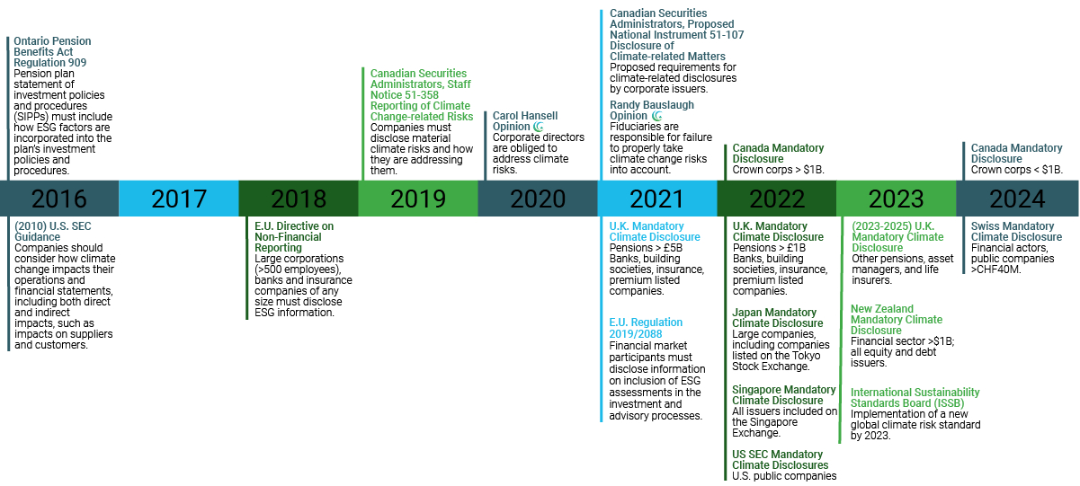
4. Complying with changing disclosure requirements
Notes:
Slide 14
Organizations need to assess what is material to their strategy and publicly-listed companies in Canada need to be aware of the nuanced differences in materiality reporting requirements in their disclosure decisions as between the national instruments, provincial and territorial securities law, corporate statutes, and exchange listing requirements. For example, NI 51-102 defines ‘material change’ as material change means (a) a change in the business, operations or capital of the reporting issuer that would reasonably be expected to have a significant effect on the market price or value of any of the securities of the reporting issuer; or (b) a decision to implement a change referred to in paragraph (a) made by the board of directors or other persons acting in a similar capacity or by senior management of the reporting issuer who. Audit Committees and Effective Climate Governance, Canada Climate Law Initiative, 13 December 2020
IFRS sustainability standards board
CFA Institute ESG Disclosure Standards for Investment Products
Canada Expert Panel on Sustainable Finance presented a package of practical, concrete recommendations needed to bring sustainable finance into the mainstream. Its recommendations included: Map Canada’s long-term path to a low-emission, climate-smart economy, sector by sector, with an associated capital plan; define and pursue a Canadian approach to implementing the recommendations of the Task Force on Climate-Related Financial Disclosures (TCFD); expand Canada’s green fixed income market, and set a global standard for transition-oriented financing; promote sustainable investment as ‘business as usual’ within Canada’s asset management community; define Canada’s clean technology market advantage and financing strategy; support Canada’s oil and natural gas industry in building a low-emissions, globally competitive future; accelerate the development of a vibrant private building retrofit market; align Canada’s infrastructure strategy with its long-term sustainable growth objectives and leverage private capital in its delivery; and engage institutional investors in the financing of Canada’s electricity grid of the future.
Expert Panel on Sustainable Finance, “Final Report, Mobilizing Finance for Sustainable Growth”, (2019), http://publications.gc.ca/collections/collection_2019/eccc/En4-350-2-2019-eng.pdf. need for private and public investment collaboration to mobilize finance at the necessary type, scale, and pace of investment and innovation required.
Ontario’s Capital Markets Modernization Taskforce Final report recommends uniform standards for corporate disclosure of material environmental, social and governance (ESG) information, but specifically recommended only mandating climate change-related disclosure compliant with TCFD, as well as broad disclosure of a corporation’s greenhouse gas emissions.
The Final Report is available here: https://www.ontario.ca/page/consultation-modernizing-ontarios-capital-markets
Prime Minister Trudeau and President Biden agreed during a bilateral meeting in February 2021 that Canadian and American public and private financial institutions will work together to advance the adoption of climate-related financial risk disclosure, including the achievement of a net-zero emissions economy. The bilateral announcement underlines that disclosure of climate-related financial risk is a necessary and urgent imperative for Canadian businesses to remain competitive, and to continue to attract capital as global investor sentiments and regulatory regimes shift towards a net-zero economy. The two leaders also pledged to work together against ‘unfair competition’, which could include measures such as partnership on a carbon border tariff adjustment that would prevent ‘carbon leakage’, or the practice of moving production away from jurisdictions with tighter carbon controls.
See the full report of the meeting here: ‘Roadmap for a Renewed US-Canada Partnership’ https://pm.gc.ca/en/news/statements/2021/02/23/roadmap-renewed-us-canada-partnership
In the UK, the Chancellor of the Exchequer announced that the UK will require certain companies to improve their climate-risk reporting for reporting periods that begin January 2021. The UK’s Financial Conduct Authority (FCA) plans to develop and finalize additional rules by the end of 2021 that will take effect in 2022 and that will apply to more entities and increase mandatory reporting. Broad, economy-wide, mandatory climate-risk disclosure rules are expected to be in place by 2025. Reporting rules are likely to be aligned with the Task Force for Climate-Related Financial Disclosures’ (TCFD) recommendations.
‘A Roadmap towards mandatory climate-related disclosures’ November 2020, HM Treasury available here: https://assets.publishing.service.gov.uk/government/uploads/system/uploads/attachment_data/file/933783/FINAL_TCFD_ROADMAP.pdf
John Coates, who joined the Securities and Exchange Commission on Feb. 1 2021 as acting director of its Division of Corporation Finance, will play a leading role to boost companies’ environmental, social, and governance disclosures, following his work on the issues at Harvard and on an SEC advisory panel. SEC Acting Chair Allison Lee directed the division to focus on climate-related disclosures as it reviews public company filings. The division will use its findings to update 2010 guidance that encouraged more robust reporting from companies about how climate changes affects their operations.
Read the statement here: https://www.sec.gov/news/public-statement/lee-statement-review-climate-related-disclosure and news article here: https://news.bloomberglaw.com/securities-law/corporate-climate-disclosures-to-get-aggressive-scrutiny-by-sec
Ontario Pension Benefits Act, RSO 1990, c P8, as amended; Regulation 909, RRO 1990, section 78 Statement of investment policies and procedures.
CSA Staff Notice 51-358 Reporting of Climate Change-related Risks, 1 August 2019, https://www.osc.gov.on.ca/en/SecuritiesLaw_csa_20190801_51-358_reporting-of-climate-change-related-risks.htm It reinforces and expands upon the guidance provided in CSA Staff Notice 51-333 Environmental Reporting Guidance and should be read in conjunction with it. It poses the following questions for boards to ask themselves: • Is the board provided with appropriate orientation and information to help members understand sector specific climate change-related issues? • Has the board been provided sufficient information, including management’s materiality assessments in respect of the issuer’s climate change-related risks, to appropriately oversee and consider management’s assessment of these risks? • Is the board comfortable with the methodology used by management to capture the nature of climate change-related risks and assess the materiality of such risks? • Is the board aware of how their investors are factoring climate change-related risks into their investment and voting decisions? • Is oversight and management of climate change-related risks and opportunities integrated into the issuer’s strategic plan, and if so, to what extent? • Has the board considered the effectiveness of the disclosure controls and procedures in place in relation to climate change-related risks?
European Union, Regulation 2019/2088, Sustainability Disclosure, the Official Journal (9 December 2019). European Union Regulations now require all pension funds and other institutional investors to disclose statement of due diligence policies with respect to the adverse impacts of investment decisions on sustainability factors, showing how investments adversely impact indicators in relation to climate and the environment (and other ESG factors); (23 April 2020), https://www.eiopa.europa.eu/content/esas-consult-environmental-social-and-governance-disclosure-rules_en. See also, European Supervisory Authorities, “Consultation Paper”, (23 April 2020), https://www.esma.europa.eu/press-news/consultations/joint-esa-consultation-esg-disclosures.
Investors have already begun to coalesce around two key reporting frameworks: the Sustainability Accounting Standards Board and the recommendations of the Task Force on Climate-related Financial Disclosures (TCFD on next slide).
CPA Canada study indicates broad disclosure of climate-related information among Canadian companies; it also suggests there may be a gap between investor information needs and current corporate reporting practices (2017), https://www.cpacanada.ca/en/business-and-accounting-resources/financial-and-non-financial-reporting/sustainability-environmental-and-social-reporting/publications/climate-related-disclosure-study.
United States - Executive Order on 27 January 2021 established a process to embed climate risk mitigation in every executive agency of the federal government,
including establishing an inter-agency coordinating process and appointing both a foreign and domestic policy lead in newly-established positions within
the White House. Even more ambitiously, on 31 March 2021, the Biden Administration announced a Jobs Plan for infrastructure reform that also addresses the climate crisis. Secretary of the Treasury Janet Yellen has stated that climate change will be a priority, creating a hub within Treasury that will focus on financial system-related risk posed by climate change, and tax policy incentives to effect change. In a speech 21 April 2021, she vowed to build on President Biden’s whole of government” approach with a “whole of economy” approach. One month later, President Biden issued an Executive Order on Climate Change Financial Risk, with responsibilities for Treasury, the Office of Management and Budget (OMB), and the Financial Stability Oversight Council (FSOC) and its constituent agencies. Among its significant aspects are initiatives to:
(1) require the development of a government-wide strategy to assess, measure, mitigate, and disclose climate change financial risk across the Federal Government;
(2) request a financial analysis of the capital needed to move the American economy to net-zero by 2050;
(3) require Treasury to work with FSOC and its constituent agencies to identify actions within each agency to identify, measure, mitigate, and disclose climate change financial risk;
(4) identify financial risk from climate within the insurance industry;
(5) identify actions that can be taken by the Department of Labor to protect pension savings and Federal pension insurance from climate change financial risk; and
(6) identify how the Federal Government can incorporate climate change financial risk into its lending, risk underwriting, procurement, and budgeting.
These actions are consistent with conclusions by the Federal Reserve Bank Board of Governors, which for the first time identified climate change as a risk to the American financial system in its Financial Stability Report (Report) of November 2020. The Report stated that further analysis would be required, since: Climate change adds a layer of economic uncertainty and risk that we have only begun to incorporate into our analysis of financial stability. Different sectors of the economy and geographic regions face different risks that will diverge from historical patterns […] [C]limate change, which increases the likelihood of dislocations and disruptions in the economy, is likely to increase financial shocks and financial system vulnerabilities that could further amplify these shocks.
The U.S. Securities and Exchange Commission published a sample latter to companies regarding climate change disclosures. https://www.sec.gov/corpfin/sample-letter-climate-change-disclosures

Slide 19
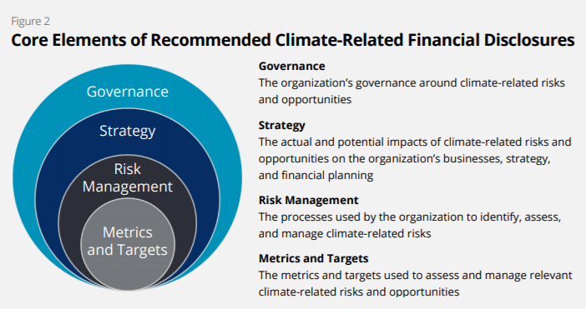
Task Force on Climate-related Financial Disclosures (TCFD): A comprehensive framework
Source: TCFD Final Report – Recommendations of the Taskforce on Climate-related Financial Disclosure
Notes:
Slide 15
Financial markets need clear, comprehensive, high-quality information on the impacts of climate change, including the risks and opportunities presented by rising temperatures, climate-related policy, and emerging technologies.
Compounding the effect on long-term returns is the risk that present valuations do not adequately factor in climate-related risks because of insufficient information. There is a lack of granular, high-quality, decision-useful data.
CPA Canada study indicates broad disclosure of climate-related information among Canadian companies, but suggests there may be a gap between investor information needs and current corporate reporting practices (2017); https://www.cpacanada.ca/en/business-and-accounting-resources/financial-and-non-financial-reporting/sustainability-environmental-and-social-reporting/publications/climate-related-disclosure-study.
The Financial Stability Board created the Task Force on Climate-related Financial Disclosures (TCFD) to improve and increase reporting of climate-related financial information.
The TCFD has established four recommendations, supported by specific disclosures:
Disclose the organization’s governance around climate-related risks and opportunities (e.g. describe board oversight and management’s role).
Disclose actual and potential risks and opportunities (describe short, medium, and long term risks, their impact, and the resilience of business strategy to these risks).
Disclose how risks are identified, assessed, and managed (and how they are integrated into overall risk management).
Disclose the metrics and targets used (e.g. Scope 1, 2, and if appropriate Scope 2 greenhouse gas emissions).
Information about climate governance and risk management should be included in all financial filings, and when material, disclosures related to implications for strategy and metrics and targets should be provided in annual financial filings.
Effective management of financially material, climate-related risks and opportunities requires direct oversight by directors and executive leadership because climate risk is material.
The benefits of better disclosure include:
Risk assessment: More effectively evaluate climate-related risks to your company, its suppliers, and competitors.
Capital allocation: Make better-informed decisions on where and when to allocate your capital.
Strategic planning: Better evaluate risks and exposures over the short, medium, and long term.
TCFD has widespread support:
Canada and the G7 support disclosure based on the TCFD framework.
Bank of Canada has committed to reporting in alignment with TCFD.
Canada’s Large Employer Emergency Financing Facility (“LEEFF”) offers bridge financing for large Canadian employers impacted by the COVID-19 pandemic and requires LEEFF recipient businesses to publish annual climate-related disclosure reports.
Canadian Coalition for Good Governance ("CCGG“, representing 53 Canadian institutional investors managing $4.5 trillion of assets), supports the TCFD framework.
Climate Action 100+
Canada’s Expert Panel on Sustainable Finance suggests companies use TCFD framework to consider broader sustainability issues.
Understand where you are: Take the TCFD maturity assessment. https://www.accountingforsustainability.org/content/dam/a4s/corporate/home/KnowledgeHub/Guide-pdf/TCFD%20Recommendations%20Maturity%20Map.pdf.downloadasset.pdf
Sources:
TCFD Final Report and TCFD Implementation Guide; https://www.fsb-tcfd.org/.
Federal government Budget 2019: “By supporting these (TCFD) standards, the Government aims to raise firms’ awareness of the importance of tracking, managing and disclosing material climate-related risks and opportunities in a consistent and comparable way.” Department of Finance (Canada), “Investing in the Middle Class Budget 2019”, March 19, 2019.
Canada Expert Panel on Sustainable Finance has recommended pursuing a Canadian approach to implementing the TCFD recommendations; Final Report 2019; https://www.canada.ca/en/environment-climate-change/services/climate-change/expert-panel-sustainable-finance.html.
It is important to disclose board oversight of climate-related risks and opportunities. The TCFD recommendations are being endorsed as a global benchmark for climate-related reporting, including governance of climate issues. Materiality of climate-related issues should be determined consistently with how a company determines the materiality of other information included in their annual financial filings: TCFD 2019 Status Report to the Financial Stability Board (FSB); https://www.fsb-tcfd.org/publications/tcfd-2019-status-report/.
The Bank of Canada’s climate-related workplan includes building climate-related risks into its financial system review process; continuing to green the Bank’s operations—including energy and waste reduction, and carbon disclosure; and developing a multi-year research plan focused on climate-related risks to the macroeconomy and financial system: Bank of Canada, 2019, https://www.bankofcanada.ca/2019/03/bank-canada-joins-central-banks-supervisors-network/.
The Bank of Canada Staff Discussion Paper by Erik Ens and Craig Johnson, “Scenario Analysis and the Economic and Financial Risks from Climate Change’, Bank of Canada, Staff Discussion Paper 2020-3, (May 2020), https://www.bankofcanada.ca/2020/05/staff-discussion-paper-2020-3/ provides an overview of the main modelling approaches related to the economics of climate change. It gives examples of the types of scenarios that could generate economic and financial risks by varying assumptions on key variables, such as climate policy, in plausible ways. It uses a computable general equilibrium (CGE) model to assess the economic impacts of these scenarios and provide insights into potential financial system risks.
The Bank of England announced in 2019 that its climate disclosures will mirror the framework of the TCFD by disclosing how it integrates climate-related financial risks across its balance sheet and processes; https://www.bankofengland.co.uk/news/2019/april/boe-to-disclose-assessment-of-how-it-manages-climate-related-financial-risk.
Canada’s five largest banks and six of its eight largest pension funds have endorsed the TCFD framework.
https://www.fsb-tcfd.org/tcfd-supporters/.

Slide 20
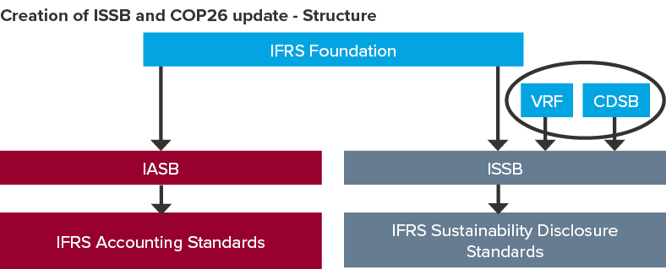
Sustainability standards have emerged, providing a basis for comparable and consistent reporting
Notes:
Slide 16
An finally, when thinking about disclosure and metrics for climate risk, it’s important to note that approaches for communicating ESG and climate related information have really matured in recent years.
Several of the leading sustainability reporting standards have merged, delivering a new, unified international reporting standard.
The IFRS, which develops regular international accounting standards, is now setting up a body to develop international, consistent, comparable sustainability reporting standards, and they will start with a climate-risk standard.
Finance ministers and central banks from 40 jurisdictions support this new international Sustainability Standards Board.
Could also have ripple effect to although doesn’t apply to Public Sector Accounting Standards directly currently.
CPA Guide questions to ask under Public Sector GAAP and statements of recommended practices

Slide 21
5. Legal duties
Duty of Loyalty
Duty of Prudence or Care
Fiduciaries must act in honestly and good faith in the best interests of their beneficiaries, impartially balance the conflicting interests of different beneficiaries, and have a duty not to act for the benefit of themselves or a third party (avoid conflicts of interest).
Fiduciaries must act with the care, diligence and skill in the administration and investment of the pension fund that a person of ordinary prudence would exercise in dealing with the property of another person.
Intergenerational implications
Duty cannot be delegated
Pension plan fiduciaries must recognize and balance current and future intergenerational risk and return considerations over periods that potentially exceed human lifetimes.
Pension trustees hold these obligations even if they delegate investment decisions and corporate engagement to asset managers.
Notes:
Slide 17
A fiduciary is anyone who is in a position of trust and who has a special responsibility to the beneficiary of the trust. Pension trustees’ fiduciary obligation is to beneficiaries.
Two Overarching Fiduciary Duties: 1) Duty of prudence and 2) Duty of loyalty.
Pension fund trustees and their investment managers have a fiduciary obligation to pension beneficiaries to act prudently in their best interests in making investment decisions regarding fund portfolios. Based on express language of constating documents, statutory law (pensions and trust laws) and common law.
Fiduciary obligation includes consideration of systemic risk, including taking a fact-based and longer-term holistic view of balancing how investment practices affect the short- and long-term interests of pension beneficiaries.
Fiduciary duty concepts are fundamental to informing investment practitioner views of risk and materiality, which extend beyond quarterly calls, financial statements and recent share price movements. The ultimate costs of systemic risks are, by definition, undiversifiable and borne by all market participants, as well as by society more broadly. A focus only on short-term performance may result in unintended consequences that can undermine future performance or later emerge as material liabilities: ICGN Guidance on Investor Fiduciary Duties, http://icgn.flpbks.com/icgn-fiduciary_duties/files/extfile/DownloadURL.pdf.
In determining asset allocation between short-term and long-term investments, the duty of care precludes short-term investments that prejudice long-term investments, as the fund must be sustained over the long-term and thus trustees must take account of systemic risks such as climate change, particularly in balancing intergenerational interests. Fiduciaries have a duty to act even where the potential costs and benefits of climate change cannot be fully quantified immediately. J Sarra, (2018), Fiduciary Obligations in Business and Investment: Implications of Climate Change.
Pension trustees cannot discharge their fiduciary obligations simply by hiring an asset manager - they may delegate investment tasks to asset managers, who themselves have a fiduciary duty to their client, but they cannot delegate their fiduciary duty.
E.g. British Columbia Pension and Benefits Standards Act
Duty of Prudence: In the administration of a pension plan, the administrator must:
(a) act honestly, in good faith and in the best interests of the members and former members and any other persons to whom a fiduciary duty is owed, and
(b) exercise the care, diligence and skill that a person of ordinary prudence would exercise when dealing with the property of another person.
(PBSA, s. 8(5) / New PBSA s. 35(3))
Pension plan assets must be invested in a manner that a reasonable and prudent person would apply in respect of a portfolio of investments made on behalf of another person to whom there is owed a fiduciary duty to make investments without undue risk of loss and with a reasonable expectation of a return on the investments commensurate with the risk.
(PBSA, s. 44(2) / New PBSA s. 60(2))
Duty of Loyalty: The provisions of subsection (5) are in addition to, and not in derogation of, any enactment or rule of law or equity relating to the duties or liabilities of a trustee
(PBSA, s. 8(6) / Not in new PBSA)
Fiduciary Duty Investments: Pension plan investments, loans and other pension plan financial decisions must be made in accordance with this Act and the regulations and in the best financial interests of plan members, former members and other plan beneficiaries.
(PBSA, s. 44(1) / New PBSA s. 60(1))
BCE Inc v 1976 Debentureholders, [2008] 3 SCR 560, 2008 SCC 69 (SCC).
The PRI suggests that the duty of loyalty includes understanding and incorporating into their decision making the sustainability preferences of beneficiaries, whether or not these preferences are financially material. The duty of prudence includes incorporating financially material ESG factors into their investment decision making, consistent with the timeframe of the obligation; being an active owner, encouraging high standards of ESG performance in the companies or other entities in which they are invested; supporting the stability and resilience of the financial system; UN PRI, Fiduciary Duty in the 21st Century Final Report, (December 2019), https://www.unpri.org/pri/fiduciary-duty-in-the-21st-century-final-report/4998.article. It notes: 1. Pension fund regulations (focusing on asset owners) – The most common types of pension fund regulations have been: (a) disclosure requirements, where pension funds are required to disclose their responsible investment commitments and/or how these commitments have been implemented; and (b) regulations encouraging pension funds to adopt responsible investment practices.
2. Stewardship codes (focusing on asset managers and asset owners) – These codes govern or steer the interactions between investors and investee companies, with a view to promoting long-term value creation strategies. 3. Corporate disclosures (focusing on individual companies, primarily publicly listed companies) – These requirements include discussing ESG issues in annual reports and accounts, and requirements to provide disclosures on specific ESG issues. There is a positive correlation between ESG and corporate financial performance.

Slide 22
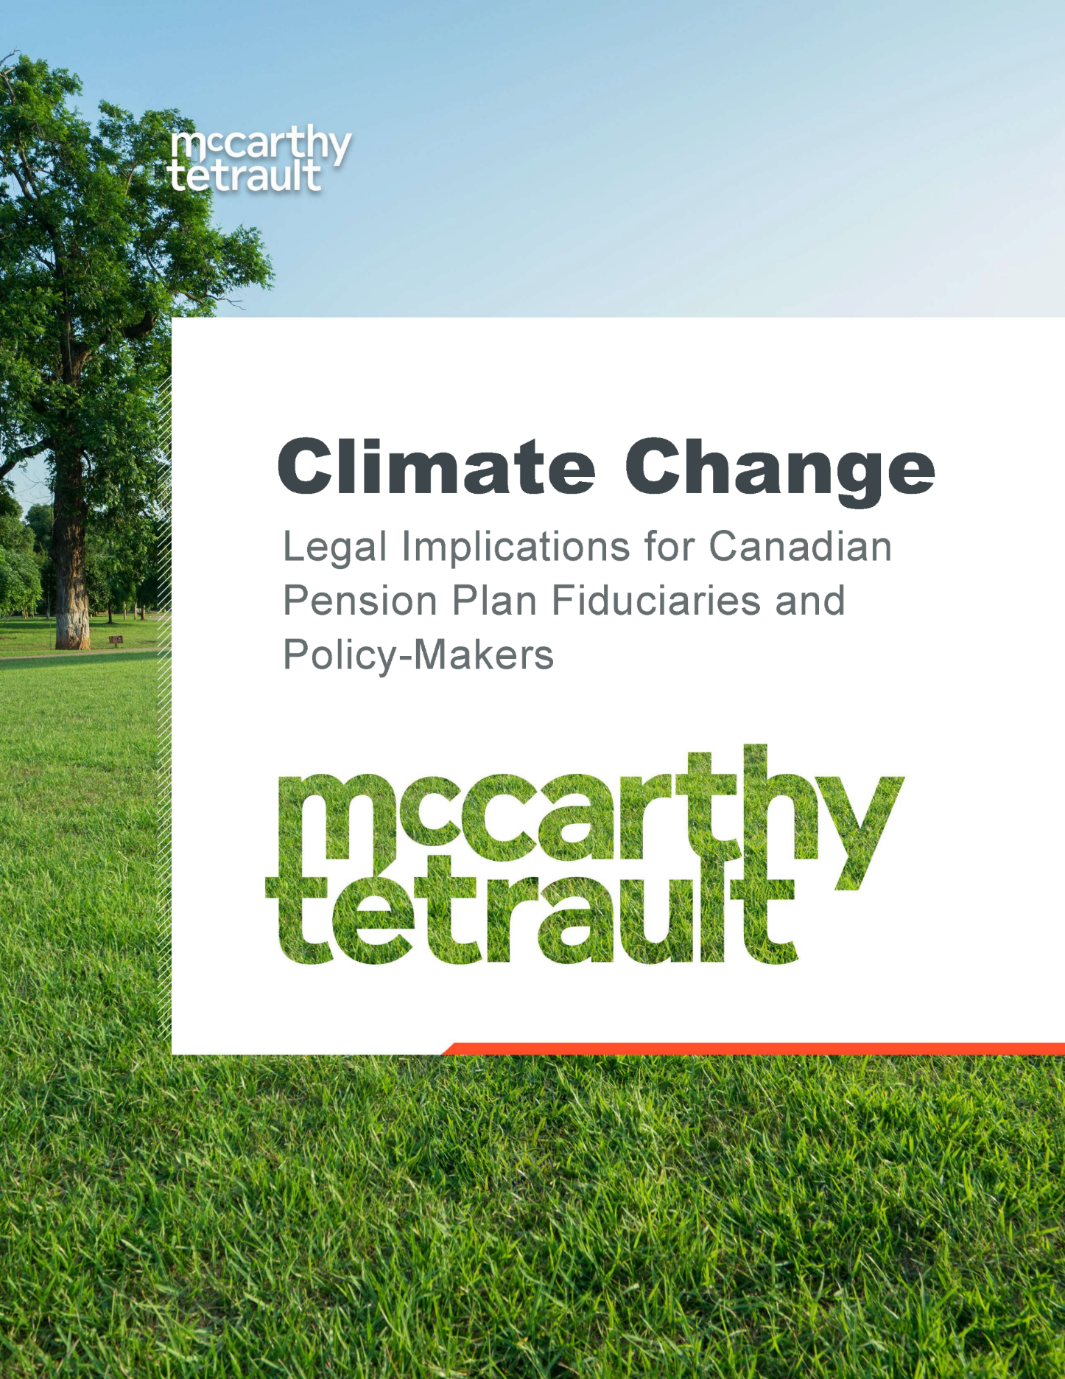
Randy Bauslaugh Opinion
‘No matter how big or how small, plan fiduciaries and their delegates are ultimately responsible for any failure to properly take climate change risks and opportunities into account. This responsibility could manifest itself in many different ways, and compensation for breach of fiduciary duty can be much more generous than under contract or tort law.
A fiduciary might face:
removal;
court ordered disclosure of information relating to climate change financial risks
fines and penalties under pension standards legislation; and
personal financial responsibility for investment underperformance or loss resulting from failure to properly manage climate change risks and opportunities, including equitable compensation or exemplary damages.’
- Legal Implications for Canadian Pension Plan Fiduciaries and Policy-makers
Randy Bauslaugh, McCarthy Tetrault, June 2021
Notes:
Slide 18
Randy Bauslaugh Opinion: https://ccli.ubc.ca/resource/climate-change-legal-implications-for-canadian-pension-plan-fiduciaries-and-policy-makers/
Pension fiduciaries have a duty to understand, consider and manage the financial risks and opportunities that climate change poses to funds and beneficiaries., as with any foreseeable financial risk.
Pension trustees/directors are not required to be experts, but where they know that expertise is necessary to enable them to act prudently, then they are required to obtain that advice from an unconflicted source.
Investor fiduciaries must consider whether fund assets are invested over an appropriate time horizon to meet current and future liabilities, are appropriately diversified and adequately consider climate factors.
Climate change has intergenerational implications. It is not only a long-term issue to protect the interests of younger pension contributors, but one that imposes short-, medium, and long-term risks and opportunities that cannot be overlooked in properly discharging duties of intergenerational fairness.
Unlike other ESG matters, the legal question is not whether fiduciaries are permitted to take climate change into account when managing plan assets, but rather, in view of the consensus.
Evidence of the materiality of climate-related risks and opportunities, whether they can ever be excused for not taking those risks and opportunities into account when investing and managing plan assets and for not reasonably disclosing what they are doing about it.
Pension fiduciaries should clearly disclose their climate strategy to their beneficiaries.
2017 Australian legal opinion is also helpful; it was published by Noel Hutley and James Mack on the obligations of trustee directors of registrable superannuation (pension) entities in Australia in respect of climate change. It observed that climate change risks should be considered by trustee directors to the extent that those risks may intersect with the financial interests of beneficiaries of a superannuation fund, particularly when making a significant decision related to investments that are exposed to climate change risk. They note that it is incumbent upon a trustee director, in an appropriate case, to consider climate change risk, in order to satisfy the requirements of due care, skill, and diligence in relation to the best interests of beneficiaries. If a trustee is confronted with a significant investment decision that involved a substantial exposure to climate change risks, it would be prudent to seek out information in relation to the risk and obtain advice on the risk, as well as keep a record of why trustees are satisfied that any investment is in the best interests of beneficiaries notwithstanding the risks. Noel Hutley and James Mack, ‘Superannuation Fund Trustee Duties and Climate Change Risk’, legal opinion to Market Forces, (15 June 2017), https://www.marketforces.org.au/wp-content/uploads/2020/01/170615-Market-Forces-Memorandum-Superannuation-Trustee-Duties-and-Climate-Change-Risk-Hutley-Mack-.pdf.
‘As fiduciaries, the boards of directors have a duty to evaluate the risks caused by climate change to change their portfolios. This requires going beyond just passive receipt of information and instead establishing a robust process to oversee and verify their funds’ progress in tackling climate change. Similar to financial statements that are subject to significant scrutiny by directors and auditors, the measurement and management of climate risks must also undergo adequate vetting and verification. As a prerequisite for effective oversight, boards need to acquire a thorough knowledge of how relevant and significant climate change is to their organizations’ investment strategy, financial performance, and asset allocation.’ Maziar Peihani, ‘Pension Fiduciaries and Climate Change: A Canadian Perspective’ (2021), Queen's Law Journal.
Peoples Department Stores Inc. (Trustee of) v Wise, [2004] 3 SCR 461 (SCC).
BCE Inc v 1976 Debentureholders, [2008] 3 SCR 560, 2008 SCC 69 (SCC).
Sarra, Janis and Williams, Cynthia. 2019. Time to Act, Response to questions posed by the Expert Panel on Sustainable Finance on Fiduciary Obligation and Effective Climate-related Financial Disclosures, 26 January 2019, https://law-ccli-2019.sites.olt.ubc.ca/files/2019/08/26-January-2019-Williams-Sarra-Submission-to-Expert-Panel-1.pdf.
Sarra, Janis P. 2018. Fiduciary Obligations in Business and Investment: Implications of Climate Change, (Oxford, CCLI, 2018), https://ssrn.com/abstract=3356024.

Slide 23
Current status of guidance
2022 – CAPSA to issue ESG guidance, expected to deal with climate risks
January 2022, OSFI/BoC release scenario testing for sample of regulated entities
2021-2022 – Canadian securities regulators consulting on NI-51-107, standards for reporting climate change risks
December, 2021, Financial Conduct Authority (prudential pension regulator) issues climate risk assessment policy statement (guidance)
  Probably most advanced guidance in a very similar legal jurisdiction
Bill S-243 – Climate Aligned Finance Act (March 24, 2022)

Slide 24
FCA Guidance
Principles-based framework (akin to investment and governance pension regulation in Canada)
Assumes materiality for most or all market actors - not a question
Consistent references to government/state policy targets (net zero 2050 or better)
  Timelines are only going to tighten, carbon prices are only going to rise
Applies to all actors large and small (staged implementation)
  Cf. litigation against carbon majors finding liability along full supply chain
Rationales include strong price signals, market integrity (greenwashing) and disclosure/transparency, and standardization of measurement and disclosure
Reporting at individual asset and portfolio level
On-going and more detailed dialogue on sector-wide minimums

Slide 25
A note on regulatory guidance
The entire premise of the legal duties and regulatory guidance just reviewed is to create “price signals”. The FCA guidance makes this most explicit, and acknowledges that sending price signals through carbon pricing and forcing measurement and disclosure is the objective.
As previously noted, while these activities are desirable, they have two major drawbacks:
  The degree of manipulability of “carbon compliance” activities is so great that a lot of resources are required to make this system work, and there is great risk of greenwashing, etc.
  It leaves policy-making to achieve Paris targets within the financial sector system, actors, norms and culture. This will not be enough to meet Paris targets.
Instead, it is widely recognized (I believe) that a very significant mobilization of public resources will be required to address climate change. Establishing the political conditions for that level of public investment is and should be the priority for all stakeholders. For pension funds, this should mean calls for public investment in climate change activities on a large scale.
There are a number of stakeholders working toward this goal, including unions, environmental groups, and yes, even lawyers.

Slide 26
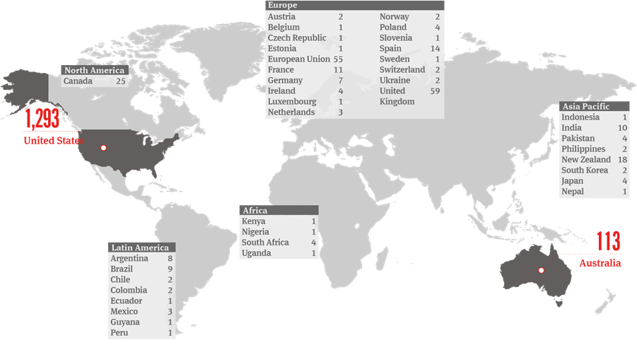
Climate litigation cases are increasing
Source: Norton Rose Fulbright, As of Feruary 2020, https://www.nortonrosefulbright.com/en/knowledge/publications/0c9b154a/climate-change-litigation-update
Notes:
Slide 19
Failure to act leaves companies and their fiduciaries vulnerable to charges that they have breached their duties.
Climate litigation more prevalent against government, with fewer corporate and financial market cases.
However, a Dutch Court has ordered Royal Dutch Shell (‘Shell’) to reduce greenhouse gas emissions by 45% by 2030 from 2019 levels, significantly faster than its current plans. The court ruled that Shell has an obligation under both Dutch law and the European convention on human rights.
Also, in McVeigh v. Retail Employees Superannuation Trust, a $57bn Australian superannuation fund settled a court case with a 25-year-old member who accused it of failing to act in his best interests by not properly considering the risks the climate crisis poses to investments. Before the trial was set to begin, REST reached a settlement with the plaintiff and set out the details of the settlement in a press release. REST acknowledged that "Climate change is a material, direct and current financial risk to the superannuation fund across many risk categories, including investment, market, reputational, strategic, governance and third-party risks." To address this risk, REST agreed to implement a net-zero carbon footprint by 2050 goal for the fund, to measure, monitor and report climate progress in line with the Task Force on Climate-related Disclosures, to ensure investee climate disclosure, and to publicly disclose portfolio holdings, among other commitments.
As stated in the Randy Bauslaugh opinion:
There are no Canadian pension cases as of June 2021.
However, complaints made by Canadian plan stakeholders about ongoing fund management or asset performance issues, or about specific losses or missed opportunities that are alleged to have a causal connection to climate change as a substantial contributing factor may result in regulatory intervention or concurrent or separate court proceedings.
Fiduciaries should appreciate that in the GHG Reference every government in Canada agreed that climate change is real and poses existential threats so, as a practical matter, it must be assumed that government pension regulators will be prepared to investigate in response to a stakeholder complaint, without the stakeholder incurring any legal expense.
A recently settled case in the Federal Court of Australia, McVeigh v. Retail Employees Superannuation Trust 2018 NSD1333/2018 (“McVeigh”), is likely a harbinger of climate change related legal proceedings to come.

Slide 27
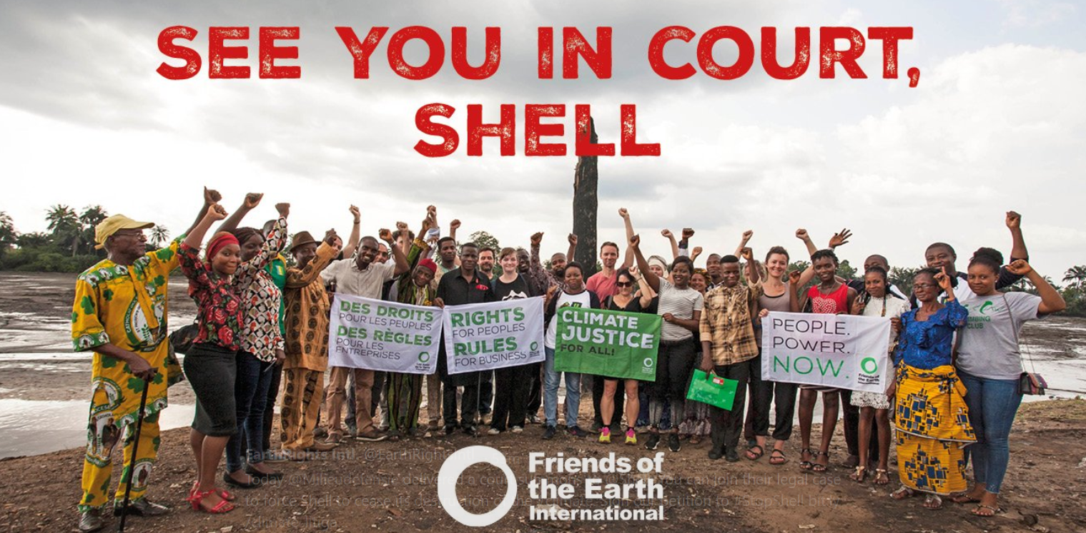
Successful litigation cases against corporates
Dutch court ordering Shell to reduce 45% of overall emission by 2030
The court recognized that Shell:
has an “obligation of result” to reduce CO2 emissions resulting from the Shell group’s activities
and a “best-efforts obligation” to reduce emissions generated by its business relations, including suppliers and end-users.
Notes:
Slide 20
Another example of successful litigation this time against the private sector actors also comes from the Netherlands, where a group of NGOs including Friends of the Earth, claimed that the oil company Shell’s plans to reduce emissions were not ambitious enough.
The Court held that there is an “unwritten standard of care” grounded in the Dutch Civil Code and informed by European and International treaties obligating Shell to take steps to reduce its carbon emissions and contribute to the prevention of dangerous climate change so that Dutch citizens may enjoy their right to life and their right to respect for private and family life.
Shell had pledged to reduce the carbon intensity of its products by 20% by 2030, 45% by 2035 and 100% by 2050 but the Court ordered that Shell (and Shell Group, including Shell Canada) has to reduce its overall emissions from 2019 levels on a net basis by 45% by 2030.
The decision applies both to Shell’s own emissions and the emissions associated with use of its products, the decision has implications for the entire supply chain.
In Australia, a young 22-year old Mark McVeigh took his pension fund to court for failing to act in his best interests by not properly considering the risks the climate crisis poses to investments
In the Retail Employees Superannuation Trust case, a $57bn Australian superannuation fund, settled with McVeigh before the trial was set to begin.
REST acknowledged that "Climate change is a material, direct and current financial risk to the superannuation fund across many risk categories, including investment, market, reputational, strategic, governance and third-party risks" and agreed to implement a net-zero carbon footprint by 2050 goal for the fund, and to publicly disclose portfolio holdings, among other commitments.
In 2020, 9 German youths filed a constitutional complaint with the German Federal Constitutional Court, alleging that the greenhouse gas emissions reduction target in the German Federal Climate Protection Act, which is 55% by 2030 from 1990 levels, is insufficient to meet Germany’s obligations under the Paris Agreement. It was further alleged that the insufficient target violates the plaintiffs’ human rights to human dignity, life and physical integrity, as protected by Articles 1 and 2 of the German Constitution, in each case in conjunction with Article 20a of the Basic Law, which provides that Germany must protect the natural foundations of life whilst being mindful of its responsibility towards future generations.
In April 2021, the Court held largely in favour of the plaintiffs.
The use of human rights arguments in climate cases continues to rise (112 human rights cases as of May 2021). The majority (93) have been brought against governments and a small but significant minority (16) brought against companies.
Positive judgments have been delivered in 25 of these cases and negative judgments in 32 (with other cases pending or settled).
“Greenwashing” claims are largely about misrepresentation and consumer protection, for example when a company publicly states that its products are environmentally friendly, but they have no concrete evidence to validate their representations.
For example, in 2021 ClientEarth launched a resource highlighting how the advertising of some of the world’s biggest fossil fuel companies is misleading the public over climate change (the companies including BP, ExxonMobil, Aramco, Chevron, Shell, Equinor, Total, RWE, Drax and Ineos).
Local governments are more likely to be in a position of bringing litigation against a national government, or a corporation, for example, suing oil and gas companies for adaptation costs.

Slide 28
What are the opportunities?
Notes:
Slide 21

Slide 29
Pathways to net-zero and the urgency of climate challenges
Infrastructure resilience
$120 billion per year
Extreme weather affects 4 billion people causing $4T in losses
Demand for solutions:
Clean Energy
Green Buildings
Green Mobility
Industrial processes
Forestry
Agriculture
Materials and waste
Sustainable infrastructure
$625B to 2050
3 million people move to cities every week
Renewables and smart grid
$10.2T to 2050
’Peak oil’ but 1.1 billion lack access to electricity
Sustainable agriculture
$4.5T to 2030
Half world’s food wasted while 1 billion go hungry
Circular economy $4.5T to 2030
7 billion tonnes of plastic waste
Credit: International Financial Consulting Ltd / Juvarya Veltkamp, 2020
Notes:
Slide 22
A pathway to net zero exists, as outlined in the International Energy Agency’s (IEA) Net Zero By 2050 report: https://iea.blob.core.windows.net/assets/beceb956-0dcf-4d73-89fe-1310e3046d68/NetZeroby2050-ARoadmapfortheGlobalEnergySector_CORR.pdf
Key milestones in the IEA roadmap include:
No new oil and gas fields approved for development, and no new coal mines starting in 2021.
No new sales of fossil fuel (‘gas’) boilers starting in 2025.
All new buildings zero carbon ready by 2030 and 50% of existing buildings retrofitted to zero carbon ready by 2040.
60% global car sales electric by 2030.
Canada’s is committed to net-zero carbon by 2050, while creating 1 million jobs: $6.64B committed to home retrofits, electric-vehicle charging stations, and planting two billion trees.
In the United States, Biden has proposed a $2T climate plan and committed to a carbon-free energy sector by 2035, delivering 10 million clean energy jobs.
The European Union is committed to be carbon neutral by 2050: €672.5B coronavirus ‘recovery and resilience’ fund; 37 percent will support green transition; 100 percent of investments must be in line with EU’s green taxonomy. https://ec.europa.eu/clima/policies/strategies/2050_en
The United Nations Conference on Climate Change (“COP 26”) sets a priority target of net zero emissions by 2050. https://ukcop26.org/uk-cop26-presidency-to-unveil-visions-of-a-global-net-zero-future/
Green industries are seeing new growth opportunities, which could result in complex reallocations of workers and assets across the economy.
IPCC target of a 45% reduction in GHG emissions by 2030 (relative to 2010) is closing in rapidly, and something in excess of $4 trillion in annual expenditures worldwide are necessary to get us where we need to go. https://www.ipcc.ch/sr15/chapter/spm/
Opportunities exist for companies to:
Access new markets with development of technological innovations such as battery storage, artificial intelligence, smart metering, and new uses of bitumen and other minerals in sustainable economic activity.
Develop new low-emissions products and services can improve competitive position and capitalize on shifting consumer and investor preferences.
Global energy grids are transforming to become digitized, distributed and decarbonized with companies successfully reducing operating costs by improving energy efficiency across production, supply and distribution processes, buildings, utilizing clean energy sources.
Demand for carbon sinks (natural and engineered) is increasing.
Sustainable infrastructure sector predicted to grow materially (Mercer 2019, +42% by 2030).
New public and private investment in renewable energy is forecasted to grow to US $2.4 trillion annually by 2035 (IPCC).
The benefits of cleaner, climate-smart growth could deliver at least US$26 trillion in economic benefits through to 2030: Global Commission on the Economy and Climate, “Unlocking the Inclusive Growth Story of the 21st Century”, Graham Institute, LSE, UK, https://newclimateeconomy.report/2018/
Review of Canada Budget 2021 Climate, Energy and Indigenous highlights: https://www.demarcoallan.com/single-post/budget-2021-key-climate-energy-and-indigenous-highlights
Mercer’s report includes the per annum cumulative effect to 2050, where notably oil and gas is -95.1%; renewables +177.9%; infrastructure +39.4%; and sustainability infrastructure +67.1%. Expected annual return impacts have significant variations by scenario, particularly for energy, utilities, materials, consumer staples and telecoms. Variations in results between asset classes and across regions, cumulative impacts, and the emphasis on sustainable opportunities provide multiple portfolio construction possibilities for investors. Mercer’s three climate scenarios provide investors with analysis of asset-class and industry-sector sensitivities to climate risk factors to quantify a forward-looking “climate impact on return.” In addition to calculating long-term annualized impacts, the model also contains a short-term stress-testing component, which enables an assessment of present-value impacts for sudden market repricing events, allowing for changes in view on scenario probability, physical damages likelihood, and market awareness: Mercer Report, ”Investing in a Time of Climate Change, The Sequel 2019”, (2019), https://www.mercer.ca/content/dam/mercer/attachments/north-america/canada/ca-2019-investing-in-a-time-of-climate-change-summary.pdf.
Green buildings are the result of a complex value chain, from conception, design, and construction through to the installation of technology and ongoing maintenance. Products to improve energy performance are increasingly in demand, along with green infrastructure and other solutions to withstand flooding and extreme events. Example, all new buildings in British Columbia are to be net-zero energy ready by 2032 (BC Energy Step Code) and zero emissions in Vancouver by 2030 (Zero Emissions Building Plan); these policies drive a $3.3 billion market for high performance building products in Metro Vancouver. “Green Building Market Forecast, Demand for Building Products Metro Vancouver 2019-2032. Measuring the Economic Impact of the B.C. Energy Step Code”, Vancouver Economic Commission (April 2019), https://storage.googleapis.com/production-vec-uploads/2019/03/GreenBuildingsMarketResearch_WEBMarch7_Launch-compressed-compressed.pdf.
Globally, fleets are going electric: by 2040, 30% passenger fleet, 70% buses and 10% heavy-duty vehicles will be electric: Electric Vehicle Outlook 2020, BloombergNEF, https://about.bnef.com/electric-vehicle-outlook/. In Canada, electric vehicles are now 3.5% of passenger vehicle sales in Canada (10% in BC, 7% in Que) since the introduction of federal incentives;
https://emc-mec.ca/wp-content/uploads/EMC-Sales-Report-2019-Q3_EN_v2.pdf.
Global energy grids are transforming to become digitized, distributed and decarbonized, Grid modernization efforts are driving $300 billion annual investment and solar, wind and batteries are expected to attract $10 trillion by 2050; New Energy Outlook 2019, BloombergNEF https://about.bnef.com/new-energy-outlook/#toc-download.
Examples of new products and services include products that can be sold on the basis of their lower carbon footprint in production and transport, and goods that emphasize reducing emissions such as adoption of energy-efficiency measures along the supply change. Cleantech sector has the potential to be a significant source of quality jobs while improving the environmental performance of Canada’s economy and building international export competitiveness. There are already 274,000 jobs in Canada’s cleantech sector, contributing $59.3 billion, or 3.1%, to GDP annually; Government of Canada, Canada’s Changing Climate Report, 2019, https://www.nrcan.gc.ca/sites/www.nrcan.gc.ca/files/energy/Climate-change/pdf/CCCR_FULLREPORT-EN-FINAL.pdf.
Canada’s clean energy sector is on track to employ 559,400 Canadians by 2030, according to Clean Energy Canada and Navius Research. While jobs in the fossil fuel energy sector are set to shrink by 0.5% every year to 2030, jobs in the clean energy sector are set to grow 3.4% annually over the next decade. Investment is expected to increase by 30% to $38 billion between now and 2030;
https://cleanenergycanada.org/wp-content/uploads/2019/10/Report_TER2019_CleanJobsFuture_20191002_FINAL-FOR-WEB.pdf
Climate change will also present new opportunities for the natural resource sectors, particularly in relation to northern economic development. Longer and warmer growing seasons can allow higher-value warmer-weather crops to be grown further north (where soil conditions permit), lengthen outdoor feeding seasons for livestock, and allow the maple syrup industry to expand northward: Government of Canada, Canada’s Changing Climate Report, 2019.
Opportunities for companies to access new markets through collaboration with development banks, governments, funds to scale-up investment in small entrepreneurial businesses in developed and developing countries as they shift to a lower-carbon economy. New market opportunities for underwriting or financing green bonds and infrastructure, such as grid connectivity, energy efficiency and transport networks: TCFD Implementation Guide, https://www.tcfdhub.org/resource/tcfd-implementation-guide/.
Mitigation, in the context of climate change, is defined as a human intervention to reduce the sources or enhance the sinks of greenhouse gases (GHG) (IPCC, 2013), since GHG have climate warming effects. Mitigation is aimed at reducing the causes of climate change: develop technologies to seriously reduce emissions at the source; support forests and other “carbon sinks” that absorb or eliminate GHG; carbon pricing mechanisms to reduce emissions; increasing local agricultural capacity to avoid long distance transport of food. Opportunities to invest and better manage climate risks and associated opportunities, such as designing new production processes, are particularly relevant for business with long-lived assets or extensive supply or distribution networks or natural resources in their value chains.
Adaptation is the process of adjustment to actual or expected climate and its effects; opportunities to develop retrofit products for buildings and build new buildings to withstand flooding and other extreme events; develop products and services to protect coastal areas with seawalls, beach nourishment and sand dunes; expand agricultural crops northward as weather warms. In human systems, adaptation seeks to moderate or avoid harm or exploit beneficial opportunities. In some natural systems, human intervention may facilitate adjustment to expected climate and its effects; “’Science assessments’ provide a way to critically analyze and synthesize existing knowledge on a topic, including an evaluation of confidence in our understanding and of remaining uncertainties”: Government of Canada, Canada's Changing Climate Report, 2019, drawing primarily from existing sources of information that have been peer-reviewed and are publicly available.
Sources: TCFD Final Report and G20 Green Finance Study Group, Green Finance Synthesis Report, 2016. Cleantech jobs stat from Expert Panel Interim Report, 2018; Goldman Sachs, 2018, ESG Revolution Rising: From Low Chatter to Loud Roar”.
For an example of investment strategy, see the Ontario Teachers Pension Plan’s Climate Report (July 2020), https://www.otpp.com/documents/10179/1021270/2019+Climate+Change+Report/f3eae93f-7531-440e-92ea-91275ec52980 lists the kinds of opportunities it is considering investing in: Clean energy – wind, solar, biofuels, waste-to-energy and hydrogen.
Sources of data for graphic:
International Organization for Migration, “World Migration Report 2015”, https://www.iom.int/sites/default/files/country/docs/syria/IOM-World-Migration-Report-2015-Overview.pdf.
International Energy Agency, Assuming no new investment, global oil production will drop by 50% by 2025, "Global oil supply without future capital investment by scenario, 2010-2025",
https://www.iea.org/data-and-statistics/charts/global-oil-supply-without-future-capital-investment-by-scenario-2010-2025.
1,942 climate laws have been adopted across the globe, “Climate Change Laws of the World”, Grantham Research Institute on Climate Change and the Environment, (20 August 2020), https://climate-laws.org/.
L Georgeson, M Maslin, M Poessinouw et al, “Adaptation responses to climate change differ between global megacities” (2016) 6 Nature Clim Change 584–588, https://doi.org/10.1038/nclimate2944.
"Investing $1.8 trillion globally in five areas from 2020 to 2030 could generate $7.1 trillion in total net benefits. The five areas we consider are early warning systems, climate-resilient infrastructure, improved dryland agriculture, mangrove protection, and investments in making water resources more resilient. This represents only a portion of the total investments needed and total benefits available”, Global Commission on Adaptation, “Adapt Now: A Global Call for Leadership on Climate Resilience” (September 2019), https://cdn.gca.org/assets/2019-09/GlobalCommission_Report_FINAL.pdf.
Peter Lacy, Jakob Rutqvist, “Waste to Wealth: The Circular Economy Advantage” (2015), https://link.springer.com/book/10.1057%2F9781137530707.
"Achieving Growth Within; A Euro 320-billion circular economy investment opportunity available to Europe up to 2025", SYSTEMIQ, in collaboration with the Ellen MacArthur Foundation (January 2017),
https://www.ellenmacarthurfoundation.org/assets/downloads/publications/Achieving-Growth-Within-20-01-17.pdf.
Investment in Sustainable Infrastructure: The Low Carbon Investment Landscape in C40Cities, C40 Cities with CDP (circa 2016),
http://c40-production-images.s3.amazonaws.com/other_uploads/images/1098_sustainable_infrastructure_projects_C40_CDP_Pipeline_report_final.original.pdf?1491265277.
Bloomberg New Energy Finance, "Clean Energy Investment Trends, 1H 2020" July 2020,
https://data.bloomberglp.com/professional/sites/24/BNEF-Clean-Energy-Investment-Trends-1H-2020.pdf.
C Bak, “2016 Canadian Clean Technology Industry Report”, Analytica Advisors, http://analytica-advisors.com/files/english-synopsis.
American Society of Civil Engineers, “Infrastructure Report Card, 2017”, https://www.infrastructurereportcard.org/.

Slide 30
Getting started: Questions to ask
Notes:
Slide 23

Slide 31

Questions for the board
Does the pension fund have a climate strategy? Does the board have effective oversight of the strategy? Is the strategy reviewed annually?
Who is responsible and accountable for implementing the pension fund’s climate strategy?
Does the board have effective oversight of management? Is management undertaking careful and thorough evaluation of climate change risks and opportunities in making decisions to invest, divest, or hold?
Has the board agreed on material metrics and targets to measure and disclose climate-related issues? Are metrics aligned with global standards? Are there clearly articulated standards and metrics to evaluate investment managers, green investment offerings, and green funds?
Does the pension fund clearly disclose its climate strategy to beneficiaries? Is the board reviewing and approving the disclosure?
Does the board have climate expertise and knowledge in its matrix of skills? If not, how is it acquiring/hiring the expertise? Which board members are taking the lead?
Does the Board participate in or support pension sector engagement with government on climate policy?
Notes:
Slide 24
No perfect tool or approach, what’s important is to get started and ask questions.
Every organization is unique – different context, clients, resource availability
Internal strategies, checks and balances can be developed
Engagement with investee companies
Supervise asset/investment managers
From these questions, there are many sub-questions to help get started:
1a. Is implementation of the climate strategy being monitored effectively against goals and targets?
1b. Has the pension fund embedded an internal price on carbon into its decision-making and investment allocation processes?
1c. Does the pension fund have a strategy to manage risks? Are there mechanisms in place to respond rapidly to changes in the pension fund’s risk profile, including oversight and monitoring of the actions of individuals charged with managing these risks?
2a. Are the managers responsible for climate-related risks and opportunities communicating effectively to the board?
3a. Has the board ensured that climate systemically informs strategic investment planning and decision-making processes?
3b. Are climate considerations embedded into the management of risk and opportunities across the organization?
3c. Has the board considered the benefits of green adaption and mitigation investments likely to have upside financial potential?
3d. Are climate risks and opportunities informed by scenario analyses?
3e. Is the board compensating portfolio managers and executives based on progress against climate targets?
4a. Is the pension fund reporting in line with the TCFD recommendations?
6a. Has the board received training on climate change governance?
6b. Does the board have a robust understanding of how climate change may affect the pension fund’s assets and investment strategies?
From CSA Staff Notice:
Is the board provided with appropriate orientation and information to help members understand sector specific climate change-related issues?
Has the board been provided sufficient information, including management’s materiality assessments in respect of the issuer’s climate change-related risks, to appropriately oversee and consider management’s assessment of these risks?
Is the board comfortable with the methodology used by management to capture the nature of climate change-related risks and assess the materiality of such risks?
Is the board aware of how their investors are factoring climate change-related risks into their investment and voting decisions?
Is oversight and management of climate change-related risks and opportunities integrated into the issuer’s strategic plan, and if so, to what extent?
Has the board considered the effectiveness of the disclosure controls and procedures in place in relation to climate change-related risks?
Sources: TCFD Implementation Guide; Sarra and Williams, Time to Act and studies cited therein; and World Economic Forum, “How to Set Up Effective Climate Governance on Corporate Boards: Guiding principles and questions”, 2019, https://www.weforum.org/whitepapers/how-to-set-up-effective-climate-governance-on-corporate-boards-guiding-principles-and-questions.
TCFD Implementation Guide offers the following: Has the organization assigned climate-related responsibilities to management-level positions or committees; do those responsibilities include assessing and/or managing climate-related issues? Organizations should describe their processes for identifying and assessing climate-related risks, including how materiality determinations are made within their organizations. Organizations should consider including the impact on their businesses and strategy in the following areas: products and services, supply chain and/or value chain, adaptation and mitigation activities, investment in research and development, types of operations and location of facilities. Organizations should describe how climate-related issues serve as an input to their financial planning process, time periods used, and how these risks and opportunities are prioritized. What are the interdependencies among the factors that affect their ability to create value over time. Organizations should describe whether they consider existing and emerging regulatory requirements related to climate change (e.g., limits on emissions) as well as other relevant factors considered. Organizations should also consider disclosing the following: processes for assessing the potential size and scope of identified climate-related risks and definitions of risk terminology used or references to existing risk classification frameworks used. What risks and opportunities are there at each stage of the business cycle: debt and equity financing, supply inputs, human resources, production facilities, utility infrastructure, transportation processes to and from production, marketing, consumers, regulators, investors, creditors?
Institutional investors have increasingly recognized their own fiduciary obligations in respect of investment decisions aimed at achieving net zero carbon by 2050; UN PRI, “Fiduciary Duty in the 21st Century Final Report” (2020), https://www.unpri.org/pri/fiduciary-duty-in-the-21st-century-final-report/4998.article.

Slide 32
Questions trustees should ask investee companies
Does the company have a climate-proof business plan? Does it have a emissions reduction plan compatible with 45% reductions by 2030?
Has the board assigned clear responsibility for implementing its climate strategy and is it effectively monitoring against targets?
Has the company assessed where climate risk is material to its business, and does it integrate climate-related financial impacts into its financial reporting?
Is the company effectively reporting its efforts to manage climate change to investors in line with the TCFD framework?
Has the company identified strategic climate opportunities for the business over the short, medium and long term, and embedded them in its business plan?
Notes:
Slide 25
SHARE (Shareholder Association for Research & Education) is a service provider that offers a shareholder engagement service that facilitates constructive shareholder dialogues with companies, amplifying the voices of small and medium-sized investors through cooperation; and improving corporate ESG policies and practices to protect its clients’ investment portfolios and the economy and environment. SHARE has a ‘four R’ approach to climate change- reduce, remedy, reallocate and regulate. SHARE’s proxy voting service allows institutional investors to exercise their voting rights responsibly: SHARE, https://share.ca/services/shareholder-engagement/

Slide 33
Questions trustees should ask their asset managers
Does the asset manager systematically integrate climate change factors into investment analysis and decisions?
Who is responsible and accountable for implementing the asset manager’s climate analysis within the investment process?
Does the asset manager undertake climate-related engagement with investee companies, and how does it measure progress? Does the asset manager engage in proxy voting in line with the goal of managing climate risk?
How does the asset manager’s active ownership practices impact its investment decisions?
Is the asset manager effectively reporting its efforts to manage climate change to the board, including integrating climate risk and return in its financial and investment reporting?
Is there a clearly articulated written mandate between pension asset owners and asset managers that sets out stewardship expectations? Is it periodically evaluated?
Notes:
Slide 26
Pension funds, as asset owners and investor fiduciaries, cannot discharge their fiduciary obligations simply by hiring an asset manager - they may delegate investment tasks to asset managers, who themselves have a fiduciary duty to their client, but they cannot delegate their fiduciary duty.
When engaging external asset managers:
Stewardship expectations should be clearly articulated in the written mandate between pension asset owners and asset managers.
There should be periodic evaluation of these terms, which contributes to clarity of expectations and promotes mutual understanding between parties.
There should be agreement that they report on how they are advancing the pension fund’s climate strategies.
Where engagement with investee companies (or potential investments) is delegated to the fund manager or service provider, is the manager/service provider undertaking engagement and proxy voting in line with the pension fund’s goals of sustainability and managing climate risk?
Is the service provider or manager effectively reporting engagement efforts to the pension board?
Does the asset manager systematically integrate climate change factors, with a view to generating investment returns to meet fund liability obligations within a prudent level of risk, over a timescale that matches the objectives of the pension fund?
In investment decisions, is the manager considering whether a company has adopted an effective climate strategy to sustain itself in a 1.5֯ or 4°C world?
Does it undertake efforts to identify and manage material risks and opportunities to the business from climate change?
Has the manager assessed effectiveness of an investee company’s oversight of its climate strategy, including monitoring and accountability mechanisms?
“Investor fiduciaries may be held accountable by fund beneficiaries, even when they choose to hire external managers and service providers to manage a portion of fund assets”: ICGN, “Guidance on Investor Fiduciary Duties”, 2018, http://icgn.flpbks.com/icgn-fiduciary_duties/files/extfile/DownloadURL.pdf
UNPRI Investment Manager Selection Guide: https://www.unpri.org/manager-selection/considering-esg-integration-in-manager-selection/26.article

Slide 34
Conclusion
Our understanding of climate change has evolved – from an ethical or environmental issue, to one that presents foreseeable financial and systemic risks. This has implications for the duties of directors and fiduciaries. Today, boards have to be able to answer questions such as:
  Is our strategy resilient to emerging climate risks?
  Do we have relevant metrics to measure and disclosure climate risks?
  Does our investment analysis account for a carbon price?
There’s no perfect tool or approach, the important is to start and ask questions.
5 reasons to put climate governance on your board agenda
Risk management
Investment strategy
Legal duty
Disclosure requirements
Changing regulation
Notes:
Slide 24
No perfect tool or approach, what’s important is to get started and ask questions.
Every organization is unique – different context, clients, resource availability.
Internal strategies, checks and balances can be developed.
Engagement with investee companies.
Supervise asset/investment managers.
From these questions, there are many sub-questions to help get started:
1a. Is implementation of the climate strategy being monitored effectively against goals and targets?
1b. Has the pension fund embedded an internal price on carbon into its decision-making and investment allocation processes?
1c. Does the pension fund have a strategy to manage risks? Are there mechanisms in place to respond rapidly to changes in the pension fund’s risk profile, including oversight and monitoring of the actions of individuals charged with managing these risks?
2a. Are the managers responsible for climate-related risks and opportunities communicating effectively to the board?
3a. Has the board ensured that climate systemically informs strategic investment planning and decision-making processes?
3b. Are climate considerations embedded into the management of risk and opportunities across the organization?
3c. Has the board considered the benefits of green adaption and mitigation investments likely to have upside financial potential?
3d. Are climate risks and opportunities informed by scenario analyses?
3e. Is the board compensating portfolio managers and executives based on progress against climate targets?
4a. Is the pension fund reporting in line with the TCFD recommendations?
6a. Has the board received training on climate change governance?
6b. Does the board have a robust understanding of how climate change may affect the pension fund’s assets and investment strategies?
From CSA Staff Notice:
Is the board provided with appropriate orientation and information to help members understand sector specific climate change-related issues?
Has the board been provided sufficient information, including management’s materiality assessments in respect of the issuer’s climate change-related risks, to appropriately oversee and consider management’s assessment of these risks?
Is the board comfortable with the methodology used by management to capture the nature of climate change-related risks and assess the materiality of such risks?
Is the board aware of how their investors are factoring climate change-related risks into their investment and voting decisions?
Is oversight and management of climate change-related risks and opportunities integrated into the issuer’s strategic plan, and if so, to what extent?
Has the board considered the effectiveness of the disclosure controls and procedures in place in relation to climate change-related risks?
Sources: TCFD Implementation Guide; Sarra and Williams, Time to Act and studies cited therein; and World Economic Forum, “How to Set Up Effective Climate Governance on Corporate Boards: Guiding principles and questions”, 2019, https://www.weforum.org/whitepapers/how-to-set-up-effective-climate-governance-on-corporate-boards-guiding-principles-and-questions.
TCFD Implementation Guide offers the following: Has the organization assigned climate-related responsibilities to management-level positions or committees; do those responsibilities include assessing and/or managing climate-related issues? Organizations should describe their processes for identifying and assessing climate-related risks, including how materiality determinations are made within their organizations. Organizations should consider including the impact on their businesses and strategy in the following areas: products and services, supply chain and/or value chain, adaptation and mitigation activities, investment in research and development, types of operations and location of facilities. Organizations should describe how climate-related issues serve as an input to their financial planning process, time periods used, and how these risks and opportunities are prioritized. What are the interdependencies among the factors that affect their ability to create value over time. Organizations should describe whether they consider existing and emerging regulatory requirements related to climate change (e.g., limits on emissions) as well as other relevant factors considered. Organizations should also consider disclosing the following: processes for assessing the potential size and scope of identified climate-related risks and definitions of risk terminology used or references to existing risk classification frameworks used. What risks and opportunities are there at each stage of the business cycle: debt and equity financing, supply inputs, human resources, production facilities, utility infrastructure, transportation processes to and from production, marketing, consumers, regulators, investors, creditors?
Institutional investors have increasingly recognized their own fiduciary obligations in respect of investment decisions aimed at achieving net zero carbon by 2050; UN PRI, “Fiduciary Duty in the 21st Century Final Report” (2020), https://www.unpri.org/pri/fiduciary-duty-in-the-21st-century-final-report/4998.article.
Audit Committees and Effective Climate Governance, A Guide for Boards of Directors, Janis Sarra. This guide draws together current legal standards and best practice guidance for Canadian audit committees, to assist them in taking a leadership role in effective climate governance. It offers practical tips for audit committees navigating a rapidly changing climate governance landscape. Audit committees are commonly delegated responsibility to undertake detailed scrutiny and oversight of financial reporting processes with key role in determining how the company’s strategies and financial results are communicated to investors, regulators, and other stakeholders. Given the growing direct and indirect financial impacts of climate change, boards of directors have a duty to adopt a climate action strategy to tackle what Canadian courts have called “an existential threat to human civilization and the global ecosystem”. https://ccli.ubc.ca/resource/audit-committees-and-effective-climate-governance-a-guide-for-boards-of-directors/

Slide 35












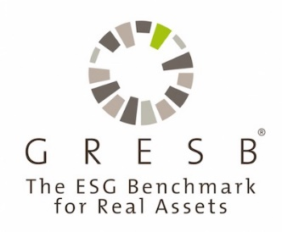

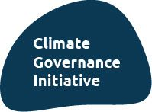






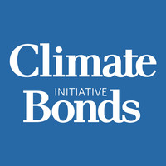
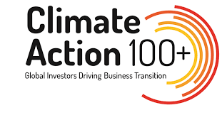
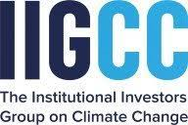
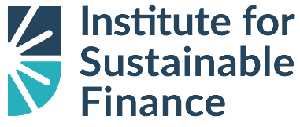




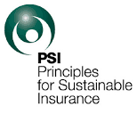

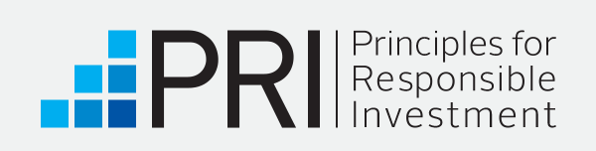
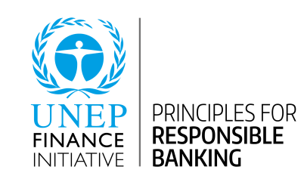

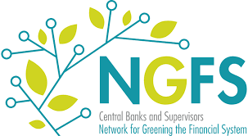



Additional resources
Climate governance education
Disclosure and reporting standards
Climate risk and scenario analysis
Sustainable finance and investment
Notes:
Slide 25
Canada Climate Law Initiative Knowledge Hub online resources for getting started and the latest research: https://ccli.ubc.ca/knowledge-hub/
CPA Canada training modules for directors to identify climate risks and opportunities
World Economic Forum, How to Set Up Effective Climate Governance on Corporate Boards
Sustainability Accounting Standards Board tools to help 77 industries identify and disclose climate issues
TCFD, ‘Implementing the Recommendations of the TCFD’ and TCFD Knowledge Hub
CFA courses
Osgoode courses
Ceres courses
RIA courses,
GARP SCR program
ICD courses
Canada Infrastructure Bank is funding projects that contribute to the objectives of the and the Pan-Canadian Framework on Clean Growth and Climate Change; https://cib-bic.ca/en/.
Canadian Standards Association Transition Taxonomy Technical Committee (TTTC), includes banks and pension funds working on a taxonomy, a financial tool to guide investment in the transition to net zero carbon emissions (forthcoming 2020).
CPA Canada, https://www.cpacanada.ca/en/business-and-accounting-resources/other-general-business-topics/sustainability/publications/adapting-to-climate-change-growth-area and https://www.cpacanada.ca/en/business-and-accounting-resources/financial-and-non-financial-reporting/sustainability-environmental-and-social-reporting/publications/climate-related-disclosure-study
World Economic Forum. 2019. How to Set Up Effective Climate Governance on Corporate Boards: Guiding principles and questions (17 January 2020), https://www.weforum.org/whitepapers/how-to-set-up-effective-climate-governance-on-corporate-boards-guiding-principles-and-questions; World Economic Forum. 2020. Global Risks Report 2020, https://www.weforum.org/reports/the-global-risks-report-2020.
Sustainability Accounting Standards Board, https://www.cdsb.net/sustainability-accounting-standards-board-sasb and https://www.sasb.org/knowledge-hub/climate-risk-technical-bulletin/.
TCFD Knowledge Hub, https://www.tcfdhub.org/.
MinterEllison, “Top five considerations for meaningful climate-related corporate governance”, (2020), https://www.minterellison.com/articles/top-five-considerations-for-meaningful-climate-related-corporate-governance.
European Union, Taxonomy: Final report of the Technical Expert Group on Sustainable Finance, (March 2020) https://ec.europa.eu/info/sites/info/files/business_economy_euro/banking_and_finance/documents/200309-sustainable-finance-teg-final-report-taxonomy_en.pdf.
Climate Bonds Initiative, https://www.climatebonds.net/.
Climate Disclosure Standards Board, “Framework application guidance for climate-related disclosures”, https://www.cdsb.net/climateguidance.
Ceres, “Running the Risk: How Corporate Boards Can Oversee Environmental, Social and Governance (ESG) Issues”, (20 November 2019) https://www.ceres.org/resources/reports/running-risk-how-corporate-boards-can-oversee-environmental-social-and-governance.
Bank of Canada Discussion Paper, Erik Ens and Craig Johnston, “Scenario Analysis and the Economic and Financial Risks from Climate Change”, (19 May 2020), https://www.bankofcanada.ca/wp-content/uploads/2020/05/SDP-2020-3.pdf.
European Central Bank, “Guide on climate-related and environmental risks, Supervisory expectations relating to risk management and disclosure”, (May 2020), https://www.bankingsupervision.europa.eu/legalframework/publiccons/pdf/climate-related_risks/ssm.202005_draft_guide_on_climate-related_and_environmental_risks.en.pdf.

Slide 36
Thank you!
Notes:
Slide 26

Slide 37
Appendix
Notes:
Slide 27

Slide 38
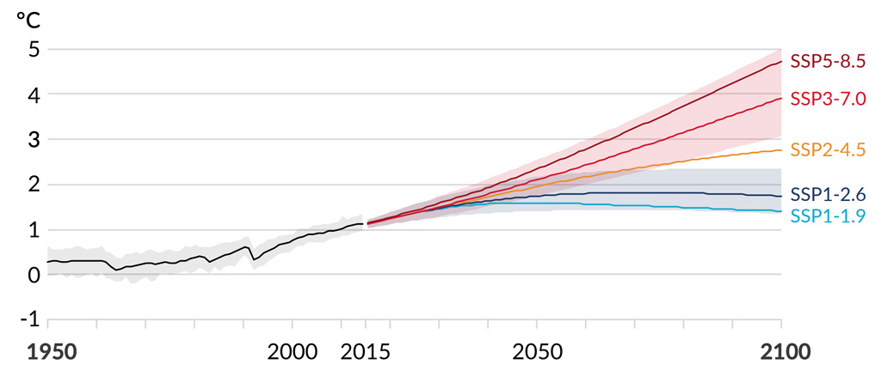
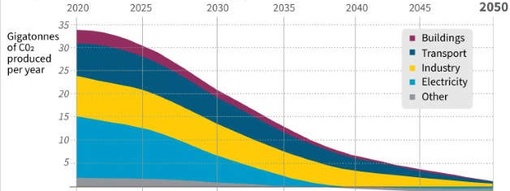
The importance of scenario analysis
STEP 1
STEP 2
STEP 3
STEP 4
Evaluate the significance of each risk
Define a group of climate scenarios
Evaluate business impacts
Identify potential responses
Political and legal
Reputation
Develop scenarios for comparison, e.g. two scenarios where the earth’s temperature stays at 0°C and that rises at 2°C respectively, by 2100.
Input costs
Operating costs
Revenues
Supply chain
Business interruption
Timing
Changes to business model
Changes to portfolio mix
Investments in capabilities and technologies
Market and technology
Physical
IPCC physical scenarios
IEA transition scenarios
Adapted from TCFD Technical Supplement: The use of scenario analysis in disclosure of climate-related risks and opportunities, 2017
Notes:
Slide 28
Within the Strategy category, TCFD recommends organizations “describe the resilience of the organization’s strategy taking into consideration different climate-related scenarios, including a 2°C or lower scenario.”
Since climate change impacts are complex, multi-faceted, and variable over time, organizations need to conduct forward-looking assessments of climate-related risk.
Boilerplate language is insufficient, investors want decision useful, credible information about climate risk exposure and how this is being addressed in an organization’s long-term strategy.
E.g. 27% of TSX listed companies have a climate target, yet only 15% have issued detailed plans on how to achieve their targets (Assessing Current Canadian Corporate Performance on GHG Emissions, Disclosures and Target Setting , Institute for Sustainable Finance, April 2021).
Climate Scenario Analysis is an essential tool for organizations to test their resilience in a future possibly impacted by climate change, and to deliver credible transition plans.
Scenario Analysis can help to replace inaction in response to uncertainty, with confidence, built on insight into the possible outcomes of choices.
Scenario Analysis has long been used as a tool to inform strategic discussions about business decisions in the face of uncertainty using data driven narratives about plausible future states.
Scenario Analysis does NOT:
Pick one preferred future and hope for it to come to pass.
Predict the most probable future and adapt to it (a scenario is not a forecast).
Scenario Analysis DOES:
Help people challenge their mental models of the world and lift blinders that may limit creativity and resourcefulness.
Help inform strategic decisions that will be resilient to a range of plausible futures (best case and worst case).
Once risks (and opportunities) are identified and understood, mitigation efforts are developed and applied to those risks that are material.
Scenario Analysis is an iterative process, and organizations will learn and improve their approach to the analysis over time. It could start as a qualitative narrative with some high level signposts, evolving to macro and financial analysis, and eventually in depth modelling of transition or physical risks, and adopting concrete (informed) targets.
There are many challenges for smaller organizations to assess risk and undertake scenario planning (the analysis can be resource intensive/expensive).
There are many integrated assessment models of climate change (IAM) used to advise companies and investors – these are simplified representations of complex economic and geophysical realities.
Free to use, commercially available climate scenario tools (see full list at https://www.unpri.org/climate-change/climate-scenario-analysis/3606.article):
The Paris Agreement Capital Transition Assessment (PACTA) tool: provides portfolio-level analysis of transition risk in public equities and corporate bonds, and uses asset-level data.
The Transition Pathway Initiative (TPI) – sector-level analysis of companies’ management of carbon emissions and alignment with the Paris Agreement. TPI uses company-disclosed data.
2 Degrees of Separation – company and sector-level analysis of the oil and gas sector, using asset-level data.
“The scenarios should be comprehensive, rigorous and challenging. The assumptions and methodologies in the models – such as the assumed global temperature rise, the energy mix, or whether the transition happens smoothly or abruptly – should be sufficiently transparent to allow for comparisons and external challenge. And finally, scenarios should be implemented consistently across the business, linking identification of risks and opportunities to both strategy and disclosure”: Mark Carney, Bank of England, “A New Horizon”, 2019, https://www.bankofengland.co.uk/speech/2019/mark-carney-speech-at-european-commission-high-level-conference-brussels.
“While Earth system models can simulate the climate system’s response to human emissions of GHGs, they cannot predict future human activities. Therefore, projections are made using various scenarios, or pathways, of future GHG concentrations, aerosol loading and land-use change”: Government of Canada, Canada's Changing Climate Report, 2019, at 122, https://www.nrcan.gc.ca/sites/www.nrcan.gc.ca/files/energy/Climate-change/pdf/CCCR_FULLREPORT-EN-FINAL.pdf
The Ontario Teachers Pension Plan has created its Low Carbon Economy (LCE) Transition Framework to guide a more systematic approach to help understand the potential impacts of climate change and make more informed decisions on individual public and private investments and its portfolio as a whole. At the core of the framework are three scenarios that describe what the future could look like in 2030. OTPP has processes in place that consider material climate change impacts in its investments: “OTPP Climate Change Report”, June 2019, https://www.otpp.com/documents/10179/859251/Climate+Change+Report+2018/152d6724-3d35-4f69-8971-641ec13ed737.

Slide 39
Examples of climate metrics
TCFD PROPOSED METRICS | EXAMPLE UNIT OF MEASURE
GHG emissions: absolute Scope 1, Scope 2, and material Scope 3 emissions carbon intensity weighted average carbon intensity | Mt of CO₂e Mt of CO₂e / per unit of output (e.g. unit of production, employees) Mt of CO₂e / revenue in local currency
Alignment with 2°C or lower temperature pathway | Degree and % (mis)alignment to a 2°C (or other) pathway
Carbon price(s): shadow/internal external | Price in local currency, per Mt of CO₂e
Proportion of assets and/or operating, investing, or financing activities: materially exposed to physical risks materially exposed to transition risks aligned towards climate-related opportunities | Percentage
Amount of senior management remuneration impacted by climate considerations | Percentage, amount in local currency, or weighting
Amount of expenditure or capital investment deployed towards climate risks and opportunities | Local currency
Notes:
Slide 29
There is a wide range of potential climate risk metrics and targets – all have limitations.
It’s important to start somewhere.
Differences between lower carbon, net-zero carbon, and climate positive carbon emissions.
Data and measurement are improving.
GHG emissions / carbon footprint is backward looking.
Climate value at risk emerging for real estate, agriculture, other sectors (forward looking).
TCFD was established with the aim of ensuring financial stability, rather than climate stability.
Climate Transition Pathways https://www.climatetransitionpathways.com/

Slide 40
Examples of climate targets
Net-zero relying on offsets
Net-zero relying on removal
Science-based targets
Climate-positive approach
Source: Science Based Targets Initiative Foundations for Science-based Net-zero target setting in the corporate sector, 2020, https://sciencebasedtargets.org/resources/files/foundations-for-net-zero-full-paper.pdf
Other types of targets
100% renewable energy: Can reduce energy footprint, but not all carbon is energy (e.g. refrigerants, business travel, waste).
Capex / investment target: Can increase investment in renewable energy, mitigation or adaptation projects.
Alignment with 2°C or lower temperature pathway
Risk exposure: For insurance companies, composition of book by geography, product, sector.
Notes:
Slide 30
Net-zero carbon targets
Abatement is reducing own emissions.
Carbon offsets are reducing emissions of others (compensation).
Carbon removal is removing equivalent of own emissions (neutralization).
Carbon neutral targets
- Achieve net-zero emissions through offsets, rather than abatement.
Science-based targets
Targets for abatement that are in line with Paris agreement.
Targets will be different for different industry sectors.
Renewable energy targets
- Targets for renewable energy; helps to abate Scope 1 or 2 emissions from energy or electricity use.

