Slide 1
CUPE Trustee Training Actuarial Valuations Exercise
May 16, 2022

Slide 2
Keys to a Valuation
Going Concern funding ratio (ie surplus vs deficiency)
Solvency funding ratio
Reconciliation of experience
Current service cost (or “normal cost”)
Special payment obligations
Actuarial assumptions

Slide 3
Discount Rates
Begins with an assumption about future investment returns
Can then incorporate other elements:
Provision for ‘adverse deviation’ (Pfad)
Expenses
Gains from ‘active investment management’ or ‘diversification’
Lower discount rate = higher ongoing pension cost, and highly sensitive
Common range of going concern discount rates currently 5% to 6.15%

Slide 4
Challenging assumptions exercise
Review December 31, 2015 CCRL valuation report, with particular focus on:
Summary of Results page
Going Concern results
Move to Breakout Groups — Each group to answer the following questions:
What are the employer contribution obligations after the 2015 report, either in dollar terms or as a percentage of payroll?
What was the impact of the change to the discount rate on a) the current service cost; and b) the going concern funded ratio?
How is the employer likely to respond to this valuation report?
Walk through the results of the 2017 valuation report

Slide 5
Lessons from the exercise
Review December 31, 2015 CCRL valuation report, with particular focus on:
Summary of Results page
Going Concern results
Move to Breakout Groups — Each group to prepare answers to the following questions:
What are the employer contribution obligations after the 2015 report, either in dollar terms or as a percentage of payroll?
What was the impact of the change to the discount rate on a) the current service cost; and b) the going concern funded ratio?
How is the employer likely to respond to this valuation report?
Walk through the results of the 2017 valuation report

Slide 6
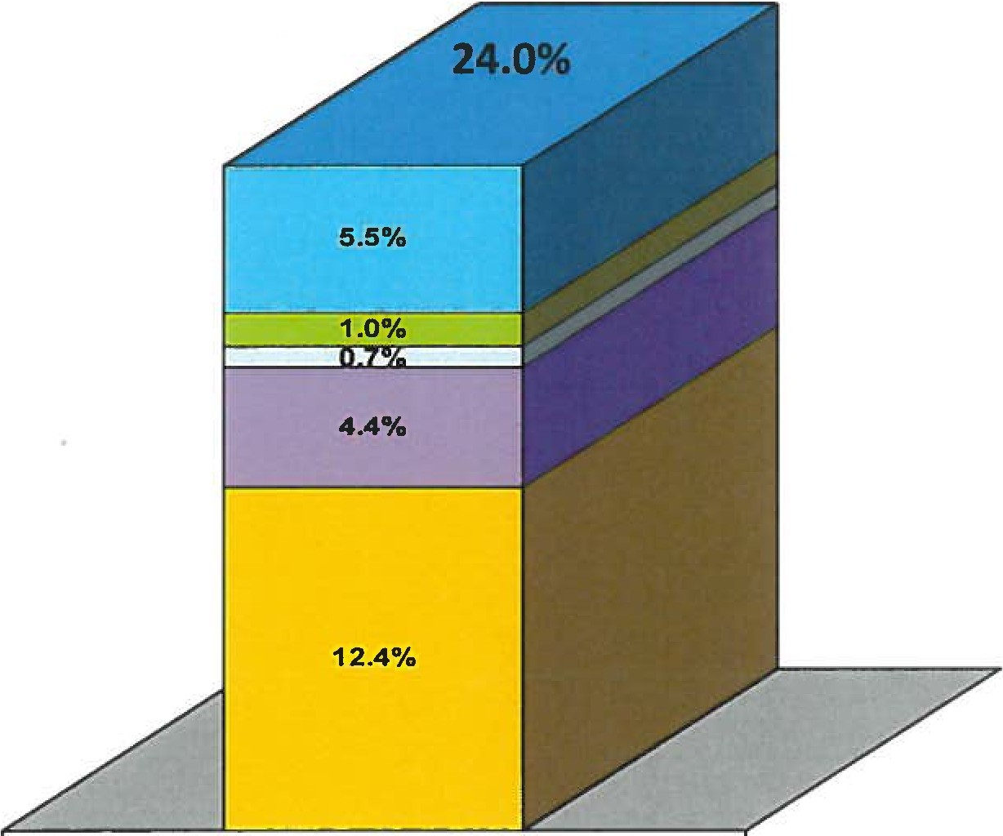
Breakdown of DB Plan Cost
Indexation 100% of CPI
Postretirement Survivor Pension 66 2/3%
Bridge Benefit 0.625%
Early Retirement Subsidies Without Bridge Benefit, Rule of 82
Basic Pension Benefit: FAE 3, accrual 1.5% below and 2% above YMPE

