Slide 1
CUPE Pension Trustee Training May 2022
Pension History, Trends and Context

Slide 2
Pension history, trends, and context in 2022
Canada’s Pension System
History
Issues we face today
CPP Expansion: 2016 Success
Bargaining Issues
The Attack on DB Plans
CPP integration

Slide 3
1. Canada’s Pension System and issues we face today

Slide 4
1952-1967: Public Pension System Established
Old Age Security – 1952 – Universal, no means test, basic pension to all Canadians based on residency, funded by federal government
Canada Pension Plan – 1966 – Mandatory public plan for workers, 25% replacement rate, funded by worker/employer contributions
Guaranteed Income Supplement – 1967 – means-tested, designed to keep seniors out of poverty, intended to be a temporary program

Slide 5
Private, Individualized Approaches
RRSP created in 1957, expanded in 1990s
TFSA created in 2009
Home buyers program 1992 + housing prices?

Slide 6
Modest Public Pensions
OAS pays ~$600/month
Maximum CPP = $1154/month
Average CPP = $720/month (new beneficiary)
Average OAS + CPP = less than $16K/year

Slide 7
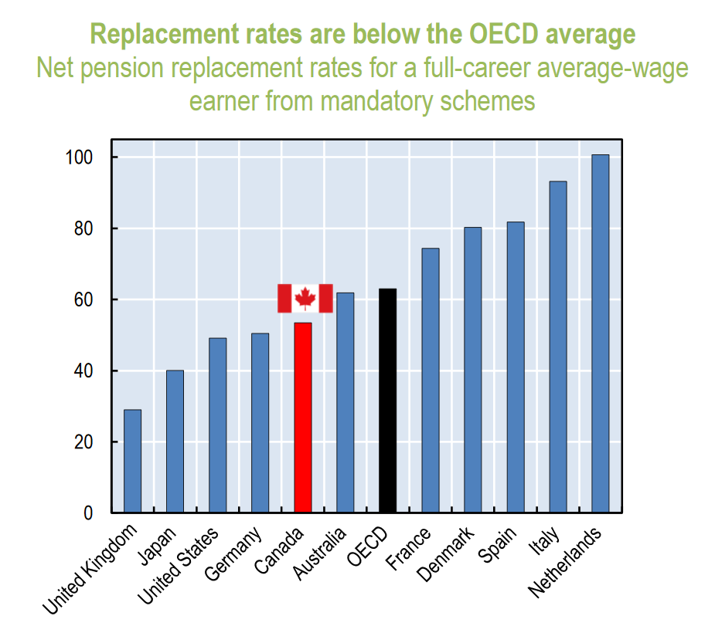

Slide 8
Pre-1980s Employer Views on DB Pensions
DB plans an effective tool to attract and retain talent
DB plans also a tool to shed workers when they stopped being productive through mandatory retirement
Early on, no accounting requirements and no/little pension regulation
DB plans were designed to serve employers’ business needs

Slide 9
1980’s to Present
From 1960s to 1980s, pensions became more strictly regulated
Private sector accounting standards required recognition of pension liabilities on company books
Private sector begins shedding DB plans starting in 1980s – mass exodus
After 2008-09 financial crisis, public sector employers began attack on DB

Slide 10
Workplace pension coverage in Canada
Canada’s modest public pension system (OAS+CPP) creates a need for workers to rely on workplace pensions & private savings arrangements to secure an adequate retirement income.
Percentage of Paid Workers Covered by a Registered Pension Plan (RPP)
In 1976 — 46.1%
In 1999 — 40.9%
In 2009 — 39.4%
In 2019 — 37.1%
88.3% of public sector workers covered by a pension plan (80% w/ DB) 22.4% of private sector workers covered by a pension plan (8.8% w/ DB)
Growing percentage of RPPs that classified as “other”, ie neither DB nor DC

Slide 11
Governance of workplace pension plans
The “governance”, or decision-making structure, of workplace pension plans can vary widely:
Collectively bargained
Jointly trusteed or joint governance
Legislated plans (including municipal)
Crucially important to understand which of these applies to your own plan, and how they can interact
“Pension Advisory Committees” have a wide range of possible authorities, from virtually none to a substantial decision-making role

Slide 12
Summary: Canada’s Pension System
Canada has always had a very modest public pension system
We therefore need our voluntary (workplace based) pension arrangements to work very well
How is that going?
Majority of workers have always had no pension at work
Those with good workplace pension plans under attack
Individual / private sector approaches not working for vast majority

Slide 13
2. CPP Expansion: 2016 Success

Slide 14
CPP deal: the basics
Changes implemented on a go-forward basis
No changes to CPP benefits you’ve earned in the past – only on benefits you earn in the future
Larger impact on younger workers – it takes 40 years for new benefits to be fully phased-in
Replacement rate benefit & contribution rate change phased in 2019-2023
YMPE benefit & contribution rate change phased in 2024-2025

Slide 15
Historic deal
Basic CPP benefit formula has not been changed since CPP created 50 years ago
Changing CPP harder than changing Canadian Constitution
Powerful right-wing groups, employer groups, insurance industry, and banks all pushing hard against CPP expansion
Deal could have fallen apart many times

Slide 16
Public Pension System Still Too Small
Partial win on CPP does not change labour’s longstanding position: the only real solution to our retirement income crisis is expansion of the public pension system
Time to shift our focus onto Old Age Security?
Workers will need to double down on defense / expansion of workplace pension plans

Slide 17
3. Bargaining Issues: The Attack on DB Plans

Slide 18
Conflicting Interests on Pensions
Employer Goal: Pay a fixed contribution rate at the lowest possible level, or avoid pension altogether!
Worker Goal: Earn a pension that will provide secure, adequate and predictable benefits upon retirement that last a lifetime and keep pace with inflation.
Employers accomplish their goals at the expense of workers being able to accomplish theirs.

Slide 19
Typical Employer Strategy (General)
Convince members their DB plan is broken or “unsustainable”
Use pension plan actuaries (as “neutral” consultants) to advance the employer bargaining agenda (employer is typically the actuary’s client)
Argue that the only way to make the plan “sustainable” is to accept plan or employer contribution rate cap, and/or conditional (i.e. non-guaranteed) benefits for some or all plan benefits
Overall attempt to make pension discussions technical (instead of political – which is what they really are)
Notes:
You will hear the “S” word a lot from employers and governments. When an employer says a DB plan is unsustainable they usually mean simply that they find it expensive.

Slide 20
Specific Employer Strategies
Cap and/or fix Employer contribution rates
Eliminate guaranteed benefits (e.g. indexing), make them conditional or ad hoc
Reduce accrual rates (ie citing CPP improvement)
Closing DB, move to DC or TB/Shared Risk
Lobby government for “flexibility” (ie Bill C-27, which would have permitted conversion of DB to TB, including retro)
Notes:
You will hear the “S” word a lot from employers and governments. When an employer says a DB plan is unsustainable they usually mean simply that they find it expensive.

Slide 21
Workplace plans and CPP expansion?
CPP expansion increases employer and employee contributions to CPP by about 1% for most CUPE members (phased-in) – higher earners will see a slightly larger increase.
Employers will likely try to pass on all of the additional employer cost (or even more) to workers through bargaining.
Employers may seek to increase the amount by which the benefit is reduced for integrated plans (integration factor).
Employers may seek to introduce an integration factor for stacked plans.
Notes:
The takeaway here is that you don’t have to say “yes.” Lower wage workers bear the brunt of integration and will benefit in retirement from the CPP enhancement if the union is able to maintain the existing plan formula.

Slide 22
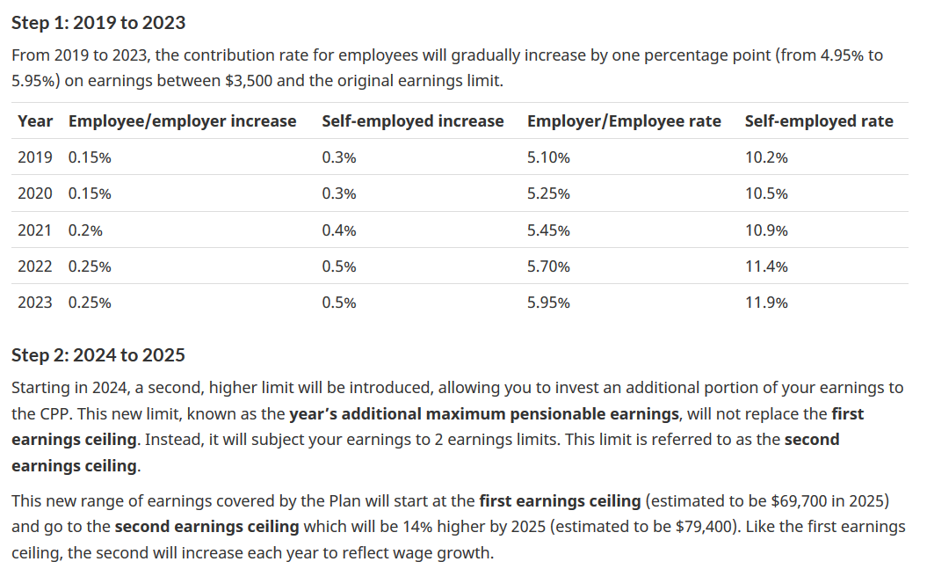
Notes:
“Original earnings limit” is the current “year’s maximum pensionable earnings” or YMPE. It is indexed every year. For 2019 the YMPE is $57,400. It is the first and third columns that will be of concern to your locals.

Slide 23
Red Flags!
“Pension review”
“Pension reform”
“Sustainability review”
“Funding policy”
Technical sounding processes that most often mean an employer agenda to shift risks / reduce costs
“Membership survey” to be carried out by plan or Admin

Slide 24
Trends: Pension consolidation
CAAT DB Plus
Nova Scotia PSSP
University Pension Plan in Ontario (3 plans so far)
Notes:
You will hear the “S” word a lot from employers and governments. When an employer says a DB plan is unsustainable they usually mean simply that they find it expensive.

Slide 25
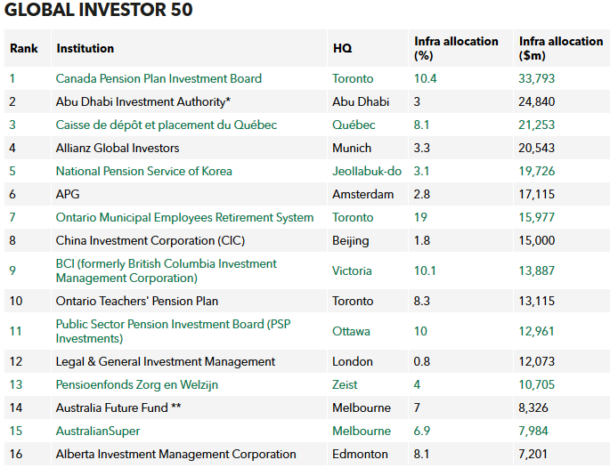
Trends to watch: pension investments fueling privatization?

Slide 26
Other trends to watch: The return of inflation
After decades of relatively low and stable price inflation (around the “target” rate of CPI of 2%), Statistics Canada has begun reporting significant and sudden increases in the rate
Average CPI for 2021 = 3.4%
CPI for March 2022 (12 month change) = 6.7%
Impact of inflation on retirees:
20 years of 2% / year inflation = purchasing power reduced to 66% of original
20 years of 6.7%/year inflation = purchasing power reduced to 25% of original
Indexation is now more important than at any time since the 1980s!
For more on CPI from Statistics Canada: https://www.statcan.gc.ca/en/subjects-start/prices_and_price_indexes/consumer_price_indexes

